Slide 1

f
BUDGET SUITES
MAKE YOUR SELF LUXURY

Slide 2
About US
Submitted By :-
 Virag Bavadiya B.
 Darshan Mangukiya V.
 Yash Bhimani P.
Submitted To :-
 Vidhyadeep Institute Of Computer & Information Technology
Internal Guide :- • External Guide :-

Slide 3
Project Profile
Project Title :- Hotel Booking System
Platform :- Microsoft Windows 11
Front End :- Visual Studio 1.86.2
Back End :- NestJs & MongoDB
Web Server :- Local Host
Submitted to :- Veer Narmad South Gujarat University, Surat.

Slide 4
Environment specific
Hardware Requirement :-
Processor :- 12th Gen Intel(R) Core(TM) i5-1240H 2.00 GHZ
RAM :- 4 GB
Hard Disk :- Minimum 20GB Hard Disk With 4GB Free Space
Software Requirement :-
Operating System :- Windows - 8
Database :- MongoDB
Browser :- Google Chrome, Mozilla Firefox

Slide 5
Existing System
Time consuming.
Existing system in one type of web application.
Can’t get public’s response.
Customer some of rarely facility not available.
Data management working properly.
There is facility for live communication.
Can’t say to customers by sending SMS.

Slide 6
Advantages
Notification and message sending by admin for users.
To have ability to share application link to each other.
Customer can that beauty care home made tips and share to other.
Registered or un registered user both can watch services.

Slide 7
Drawback
Password can be easily hacked.
Existence of network is necessary.
Without the proper knowledge user can not use this application.

Slide 8
Overview
Budget suites provides hotel booking services.
User can advanced booking the appointment.
It’s made for time consuming.
Our aim is “Make your self luxury.”

Slide 9
Objective
Optimize operational efficiency
Enhanced Guests satisfaction
Maximum revenue from effective management
Ensuring seamless reservation
Accurate inventory management
Exceptional Customer’s services

Slide 10
Scope
This targets individual who are interested in booking hotel or just want to enquire about the hotel and rooms.
It also enables the organisation/admin to make changes to the hotels such as updating hotel information, adding new hotels or categories of rooms or delete an outdated hotels.
It also contains the details of rooms.
In short, the administrator in charge will be able to do the following :-
Update Hotel
Delete Hotel
Add Hotel
Keep data records
Track the number of check-in and check-outs

Slide 11
Context diagram (0 level dfd)
Hotel
Available rooms
Booked reservations
Add hotel, add user, update hotel
Login/Logout, reservation, user detail
Hotel Reservation
Admin
Users
Reports, customer care management, track activities, reservation status
Hotel search, reservation availability

Slide 12
UserId
UserType
Email
Password
Password
PhoneNo
isActive
UserName
Login
User Profile
Image
User
Country image
RoomTypes
CountryName
Images
HotelAddress
CountryCode
Country
HotelId
CountryId
CountryId
Search
Hotel
LocationId
Location
TotalRooms
LocationId
HotelCode
Location image
HotelName
LocationName
LocationCode
Book Hotel
RoomType
RoomId
RoomTypeId
Room
RoomTypeName
Image
RoomName
Price
OfferId
OfferType
Room_Type_id
OfferCode
Booking Details
Offers
IsOneTIme
BookingId
ExpiredOn
RoomPrice
OfferAmount
RoomImage
TotalAmount
Booking
Payment
Discount
BookingId
TransactionId

Slide 14
SnapShots
Admin Side

Slide 15
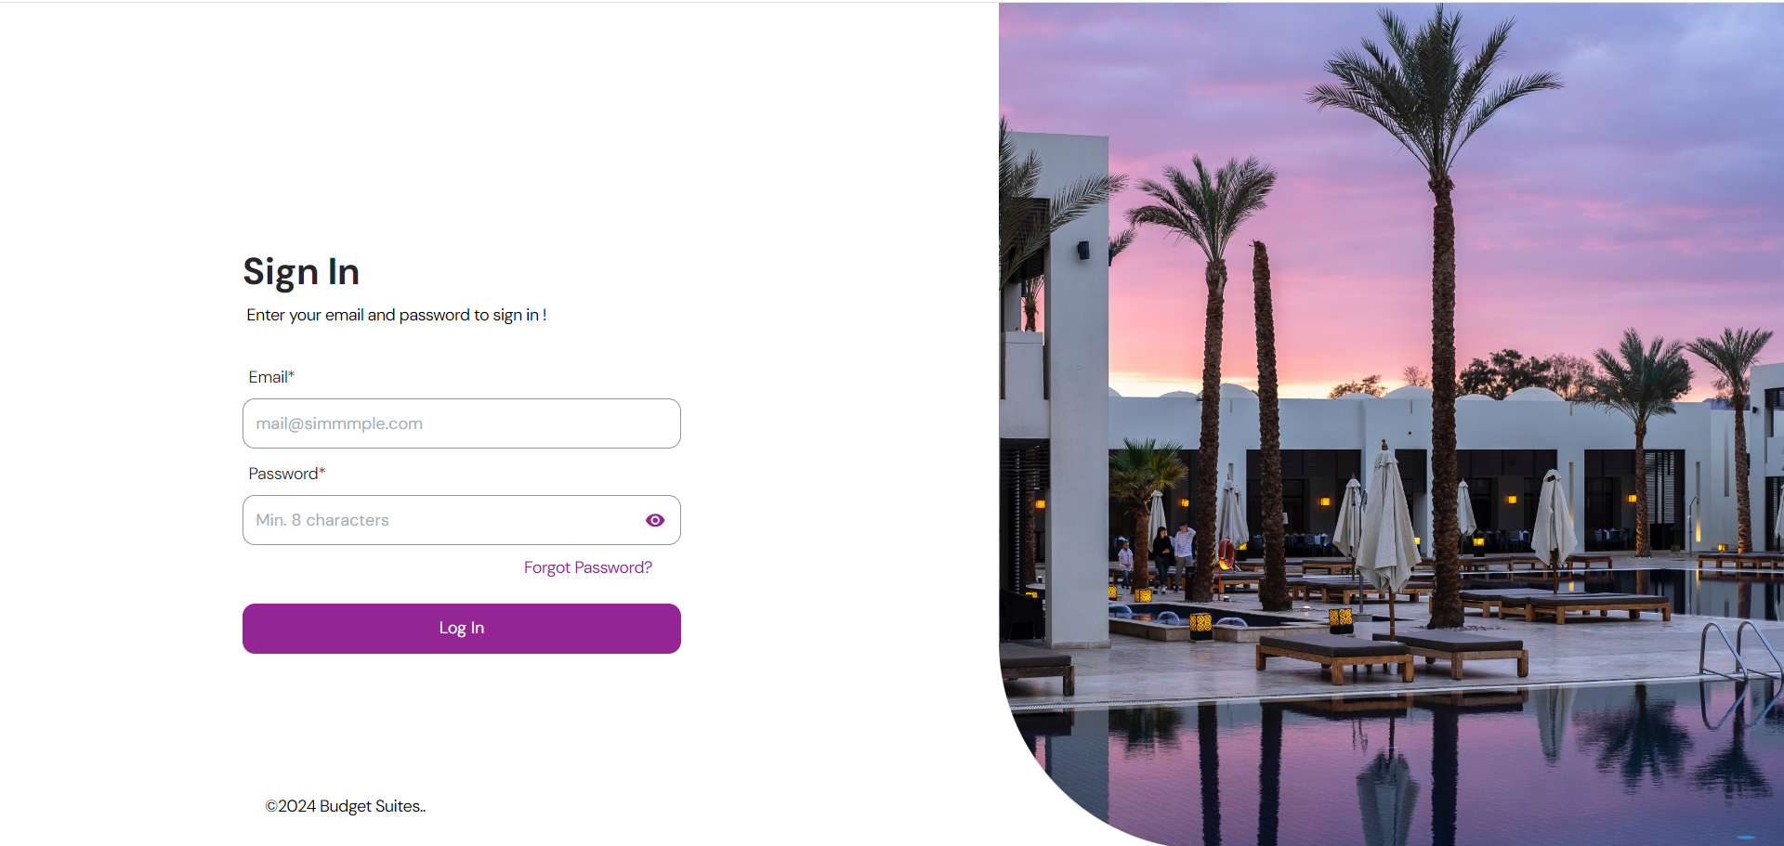
Sign-in

Slide 16
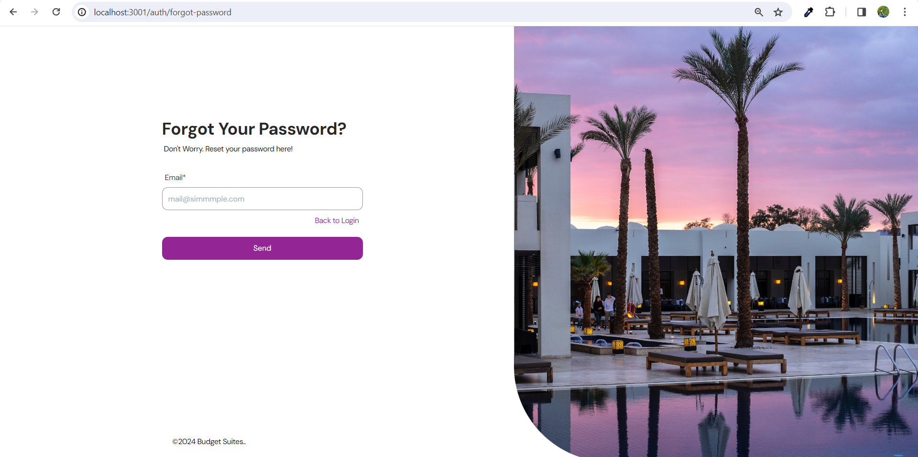
Forgot password

Slide 17
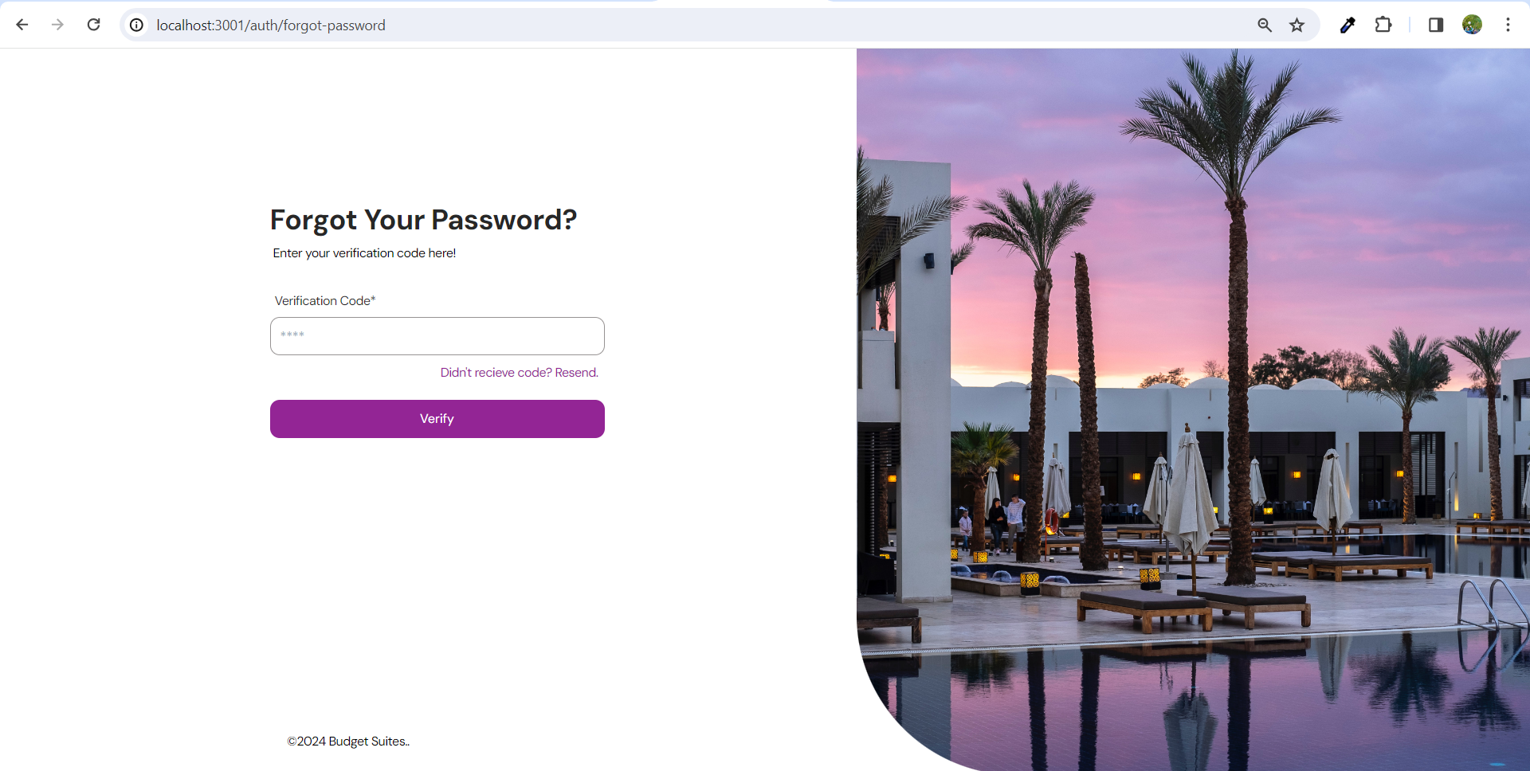
Verification code

Slide 18
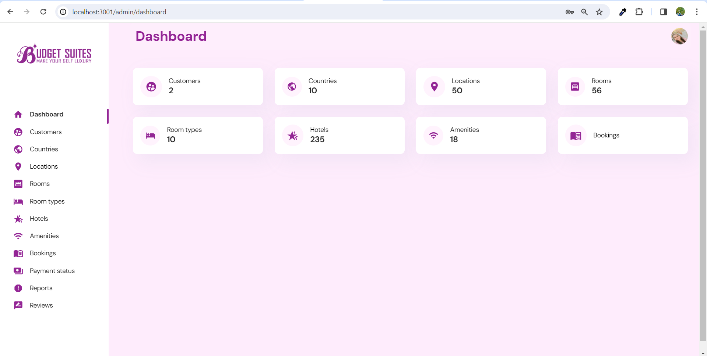
Dashboard

Slide 19
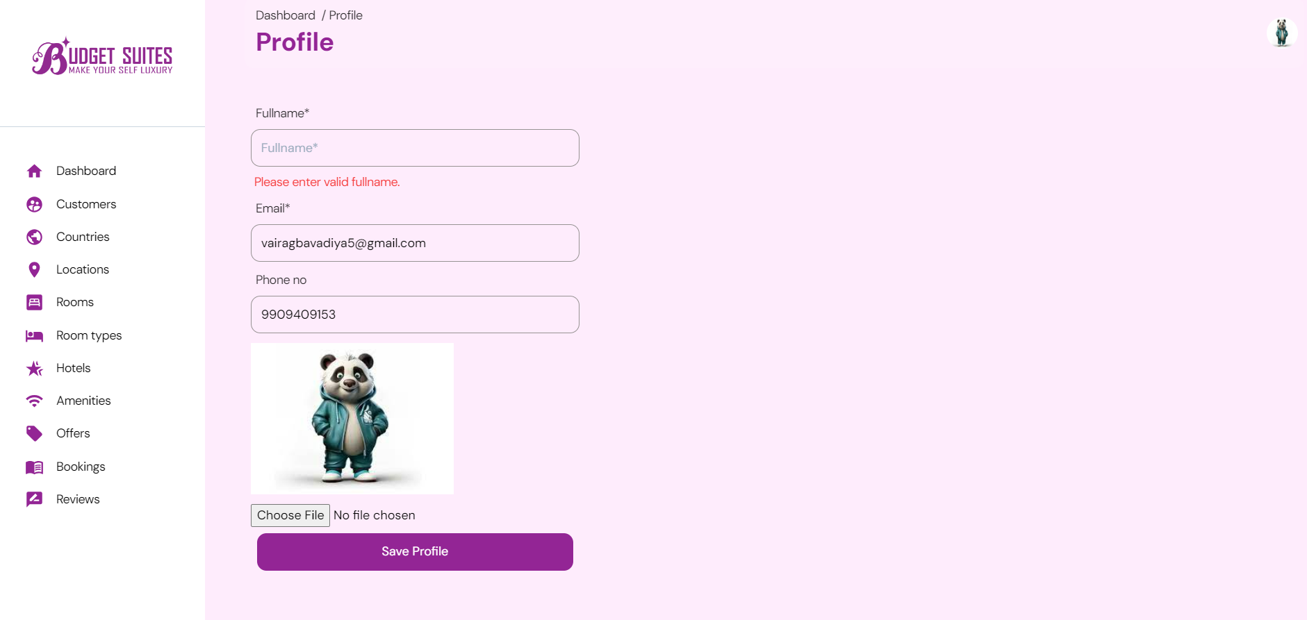
User profile validations

Slide 20
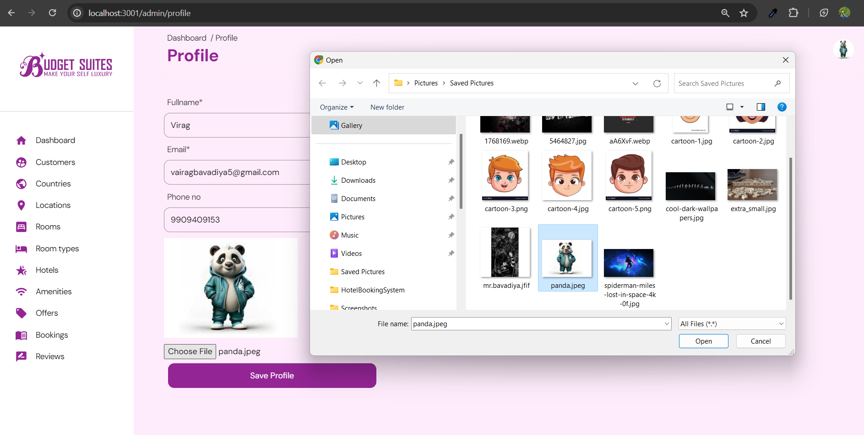
User profile photo update

Slide 21
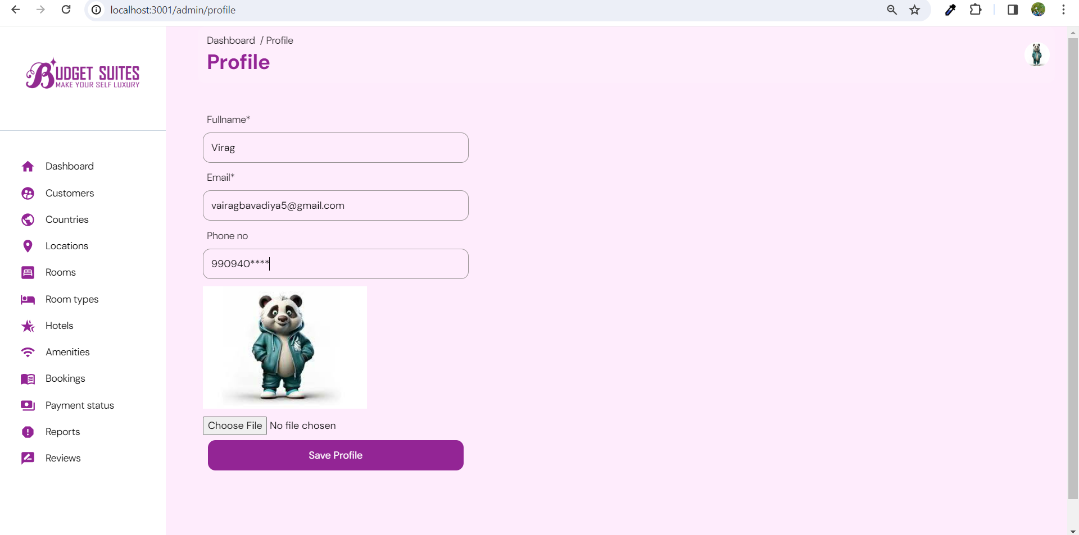
Profile

Slide 22
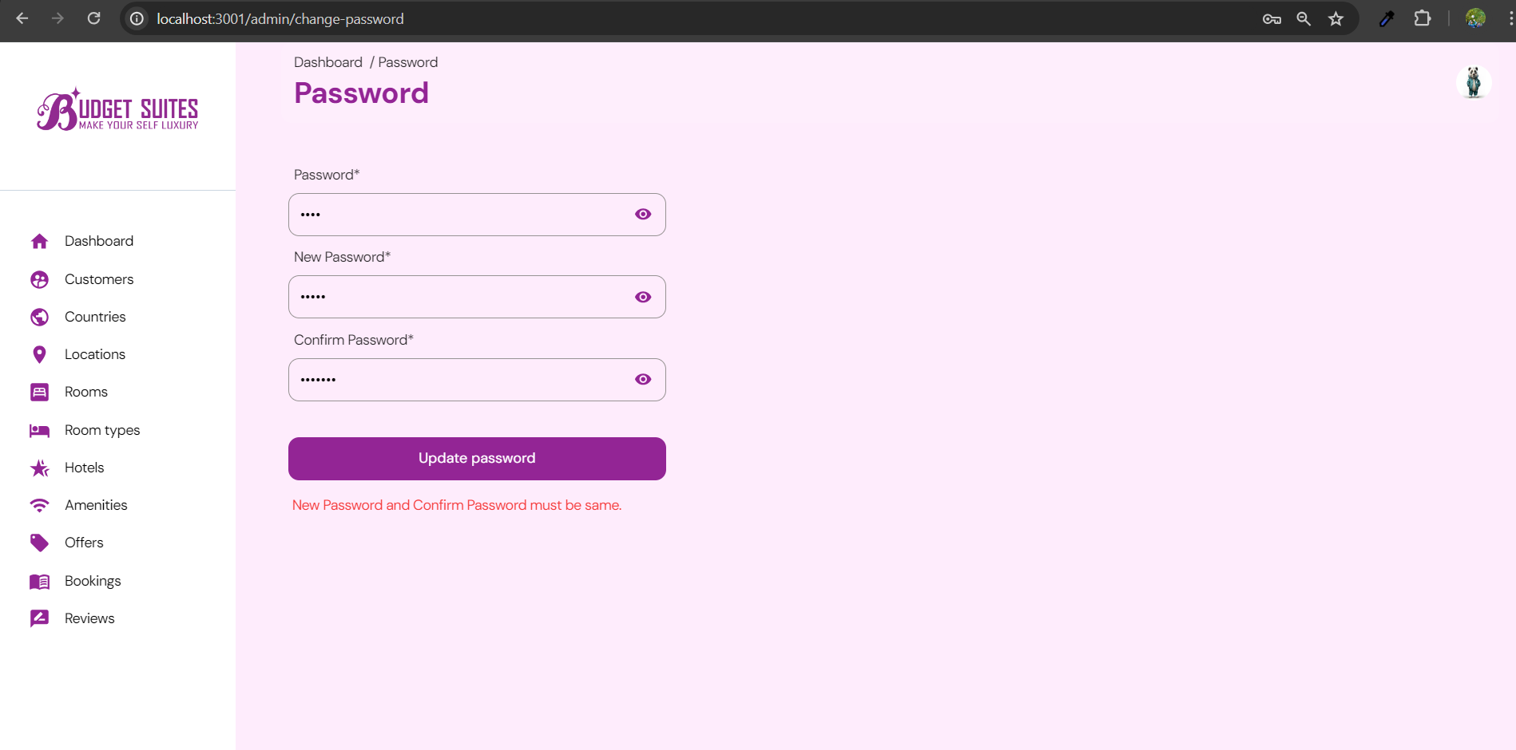
User pass validations

Slide 23
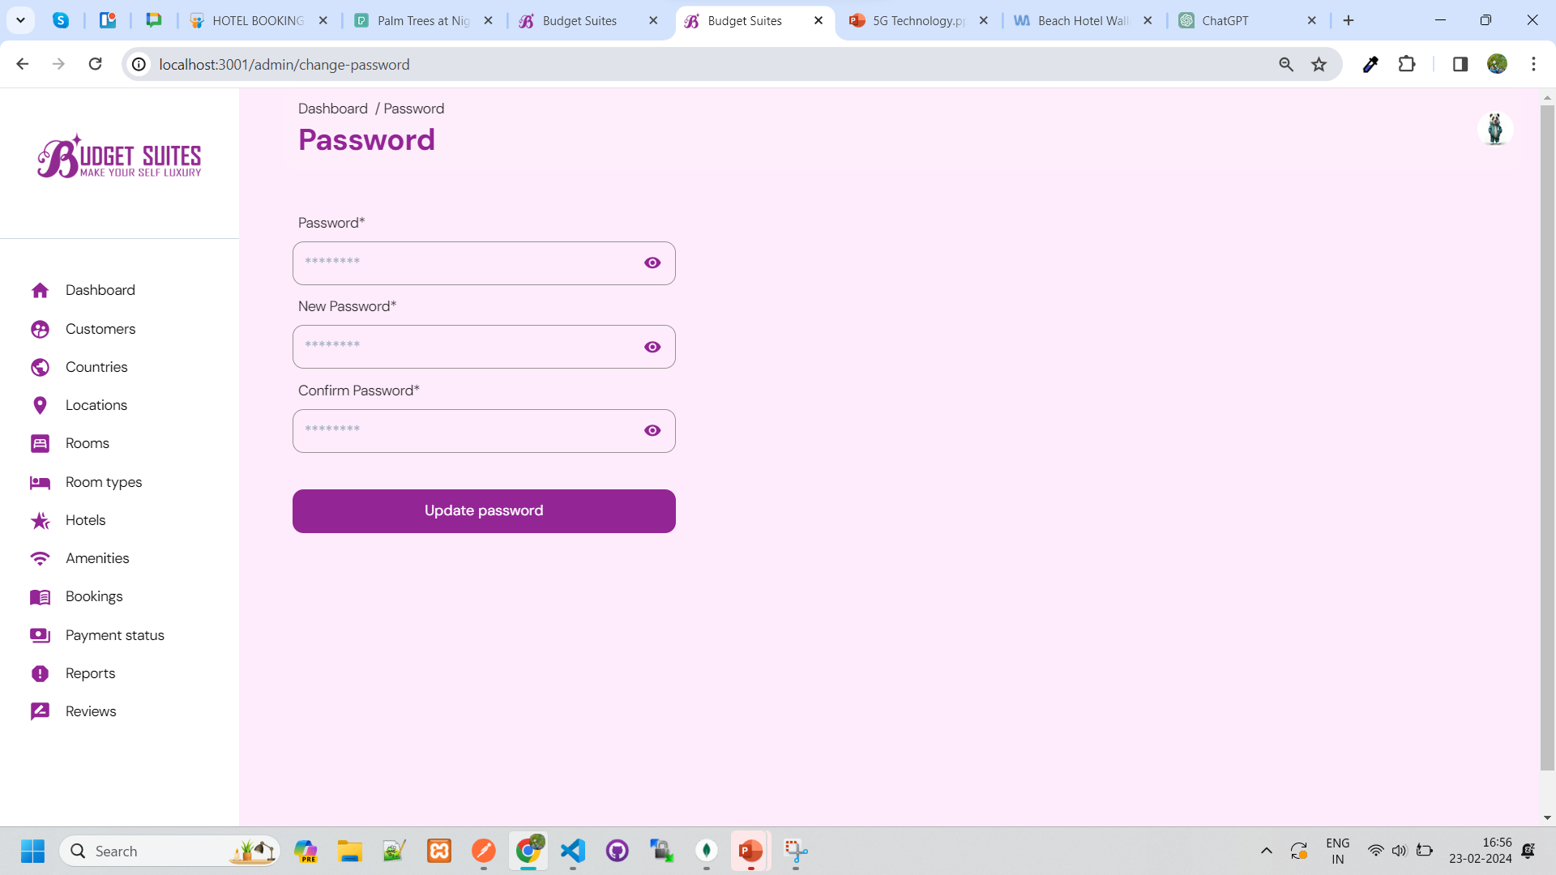
Change password

Slide 24
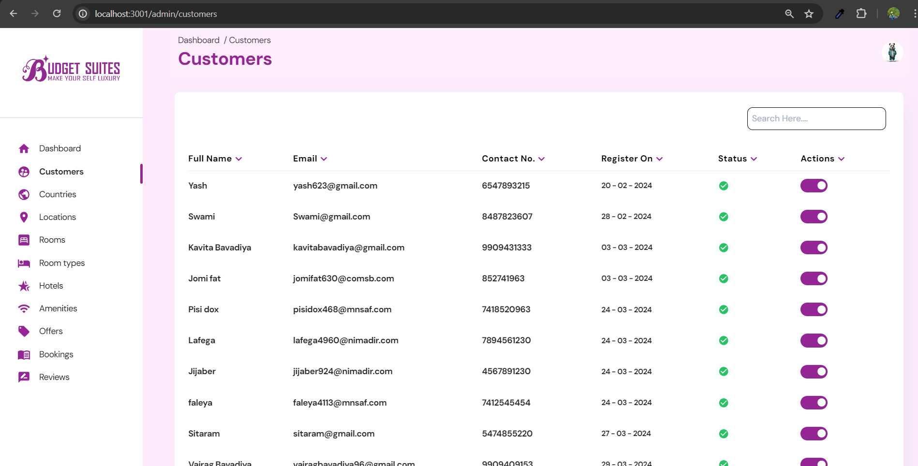
Customers

Slide 25
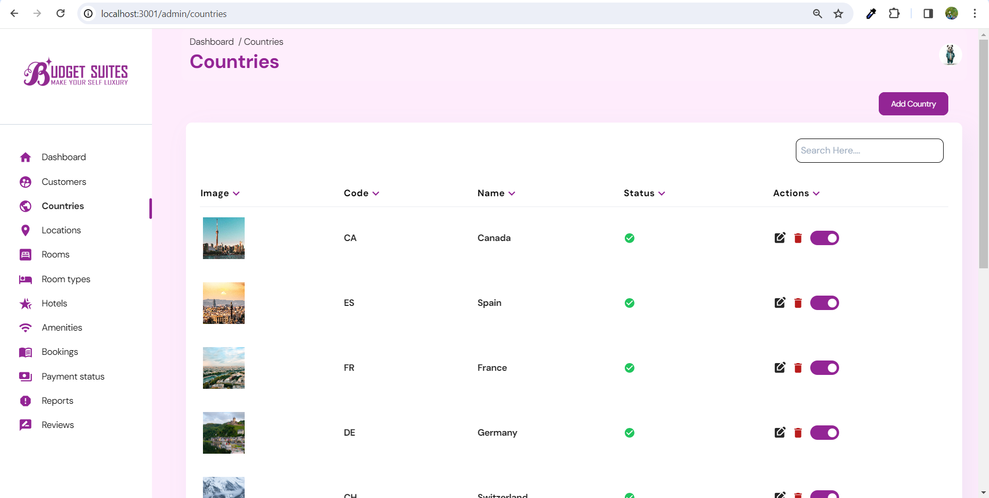
Countries LIST

Slide 26
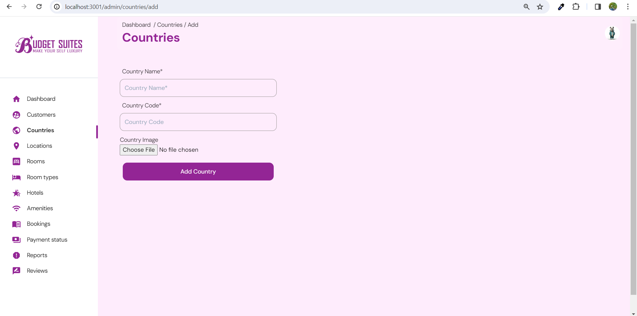
add CountrY

Slide 27
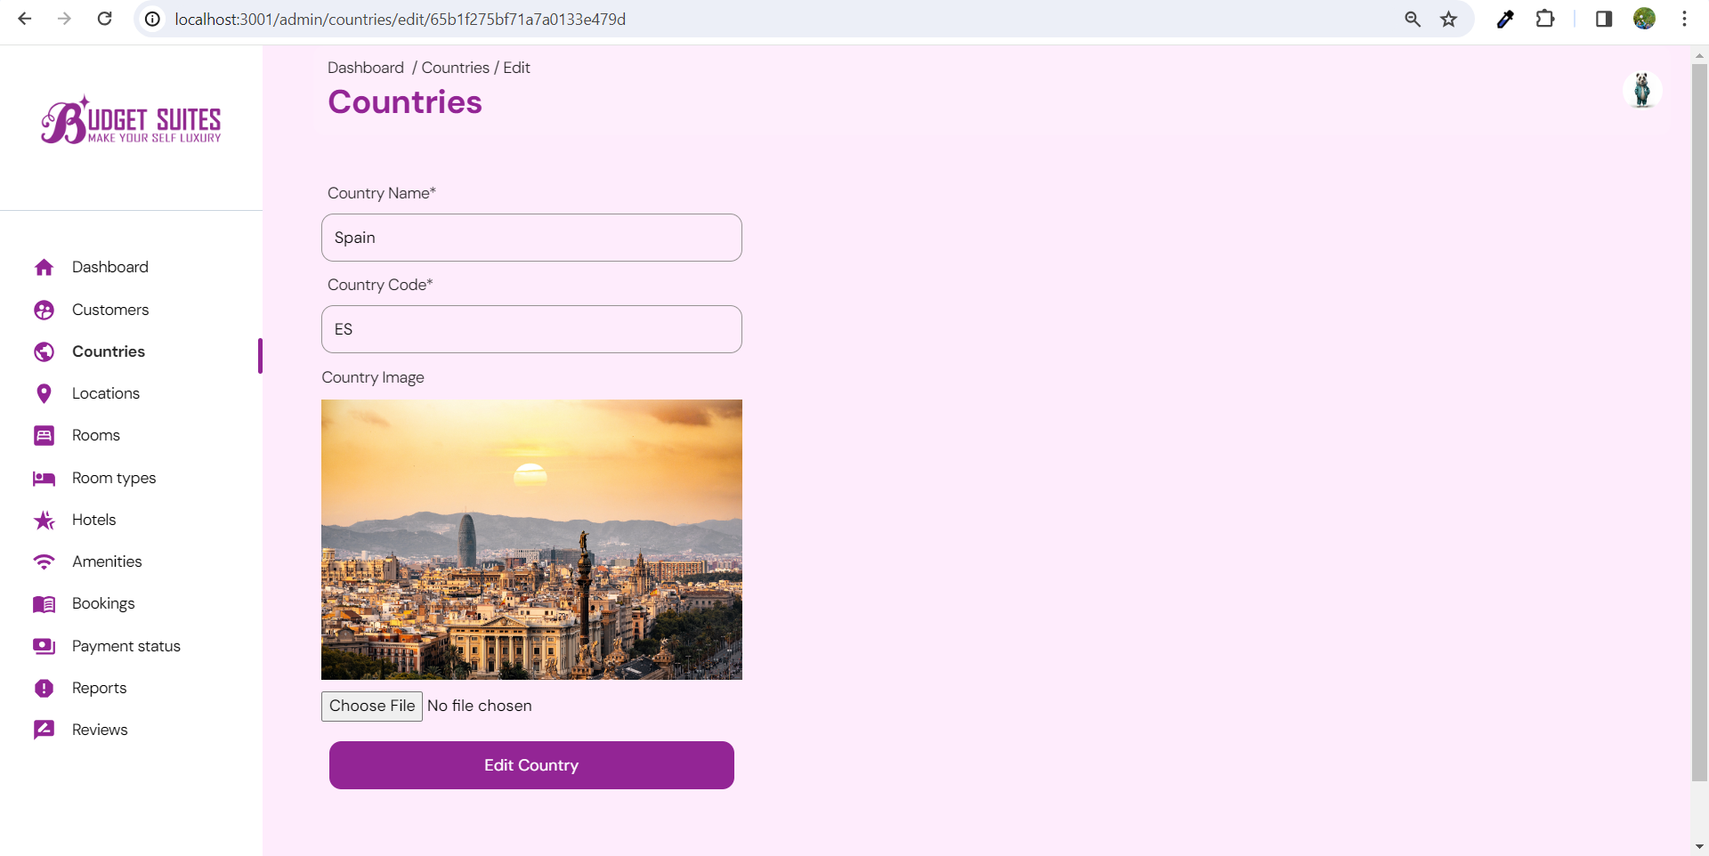
edit CountrY

Slide 28
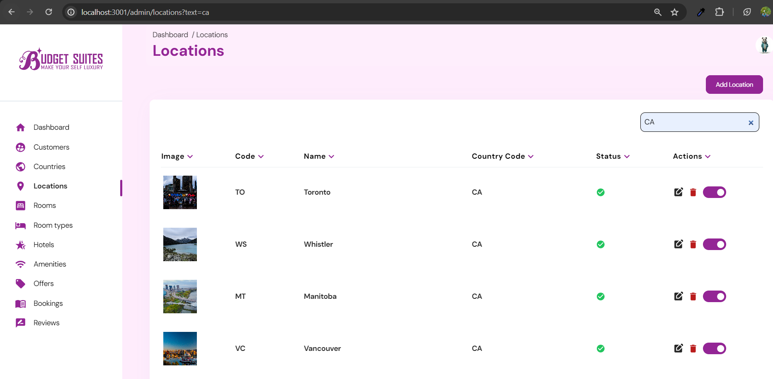
Search validation

Slide 29
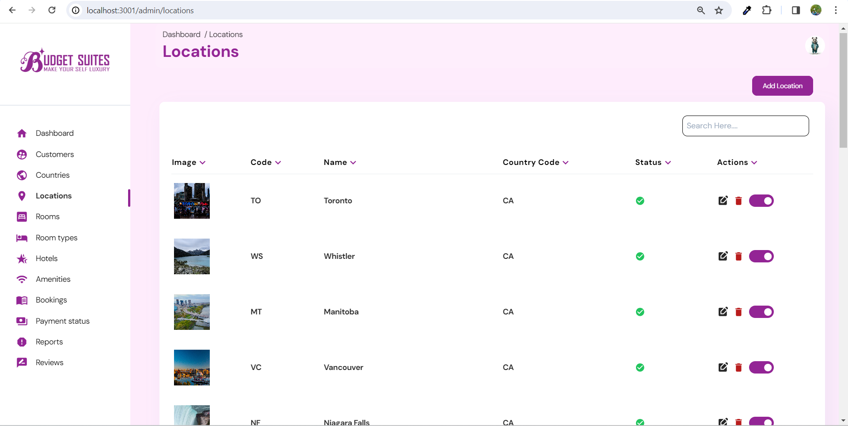
Locations LIST

Slide 30
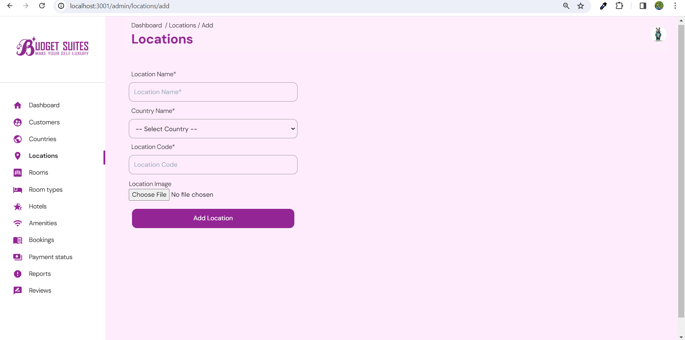
Add Location

Slide 31
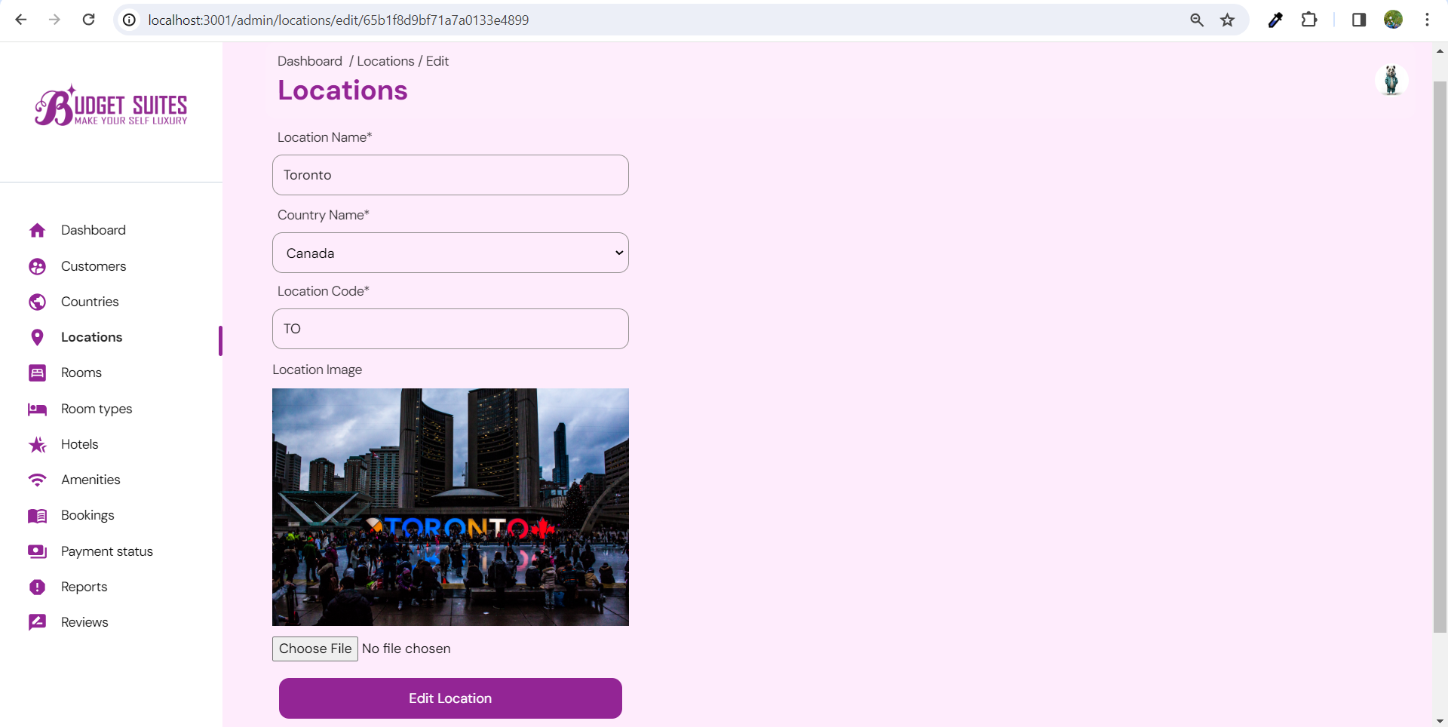
edit Location

Slide 32
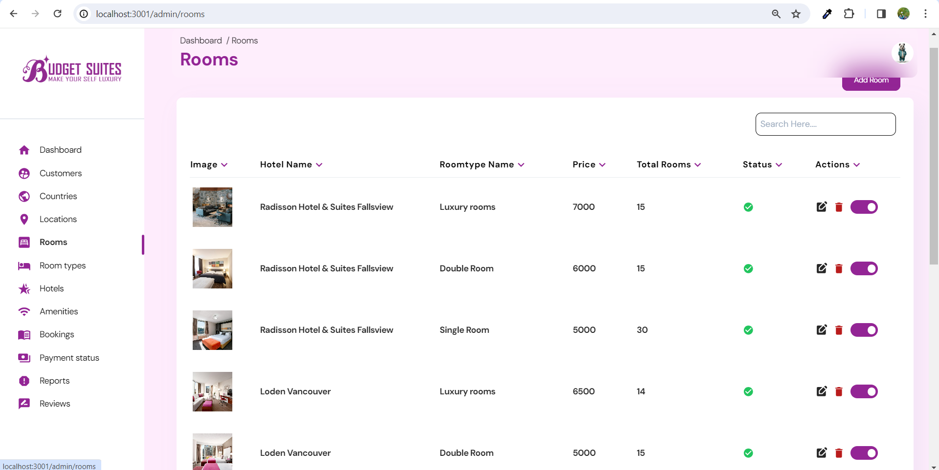
Rooms LIST

Slide 33
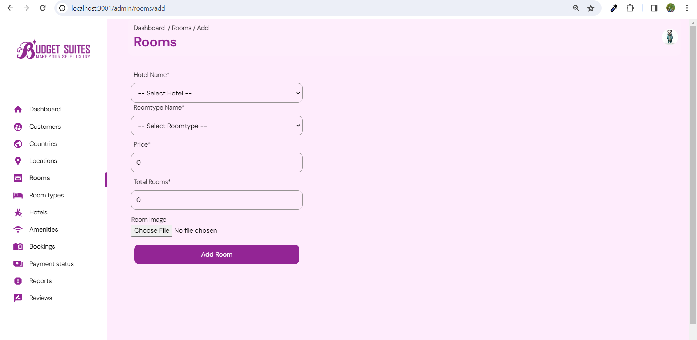
add Room

Slide 34
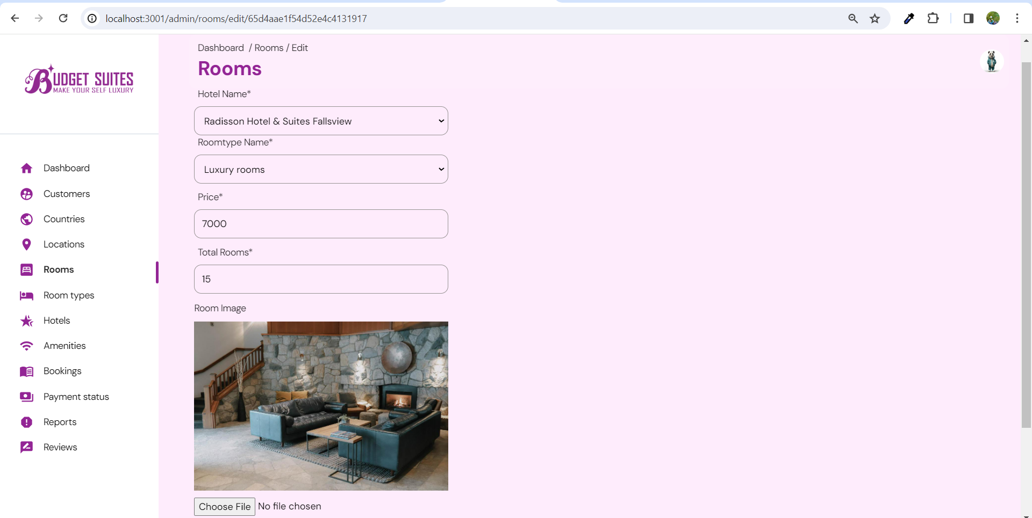
Edit Room

Slide 35
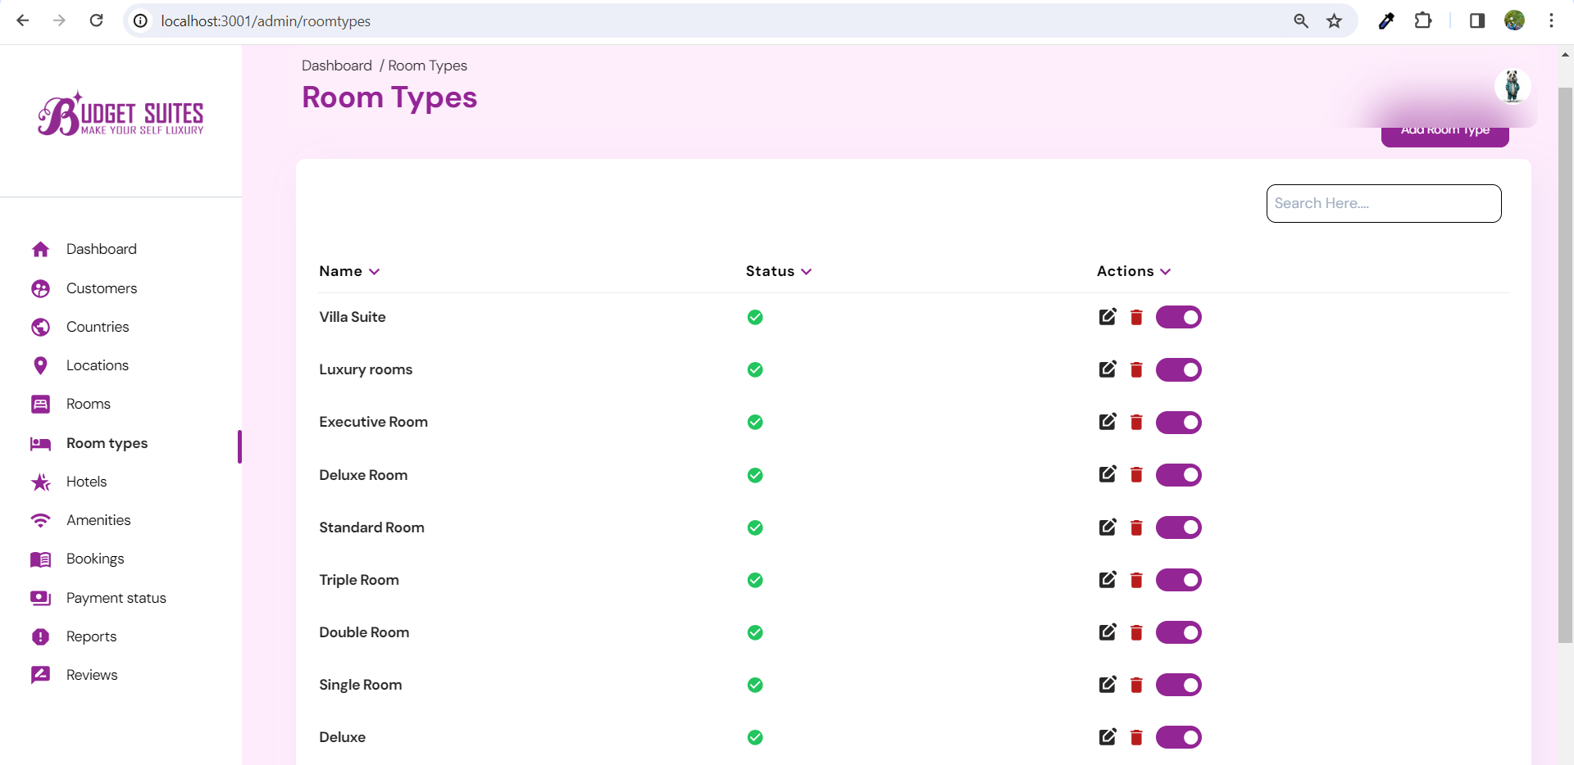
Room type LIST

Slide 36
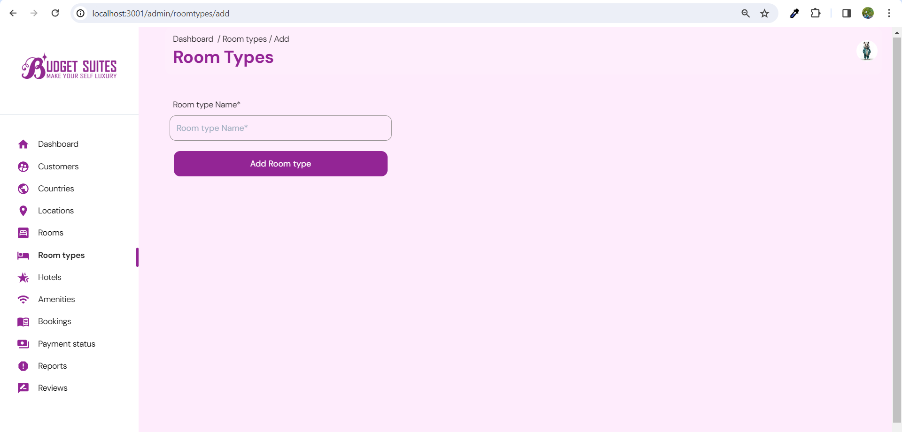
add Room type

Slide 37

edit Room type

Slide 38
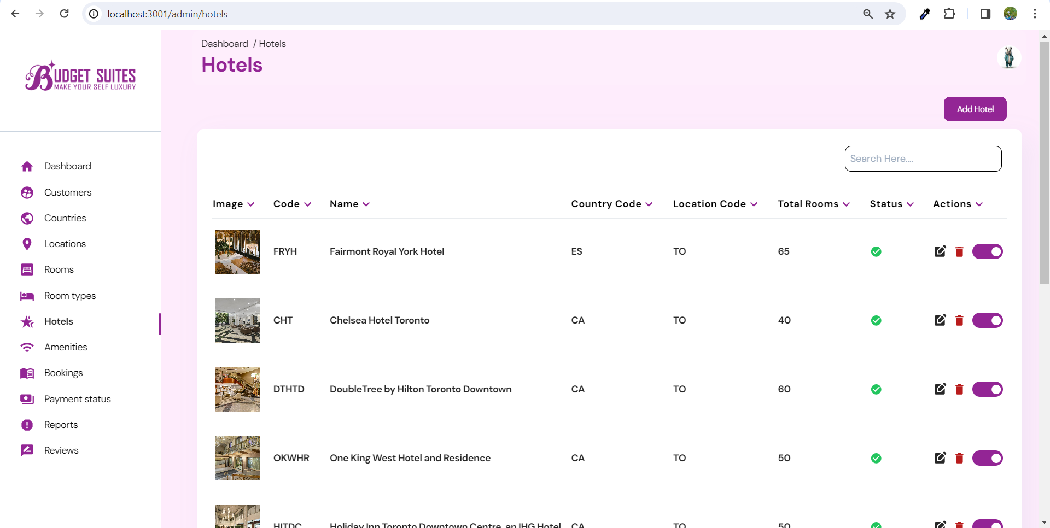
Hotels List

Slide 39
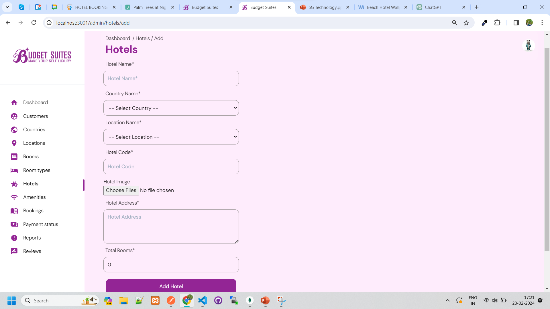
add Hotel

Slide 40
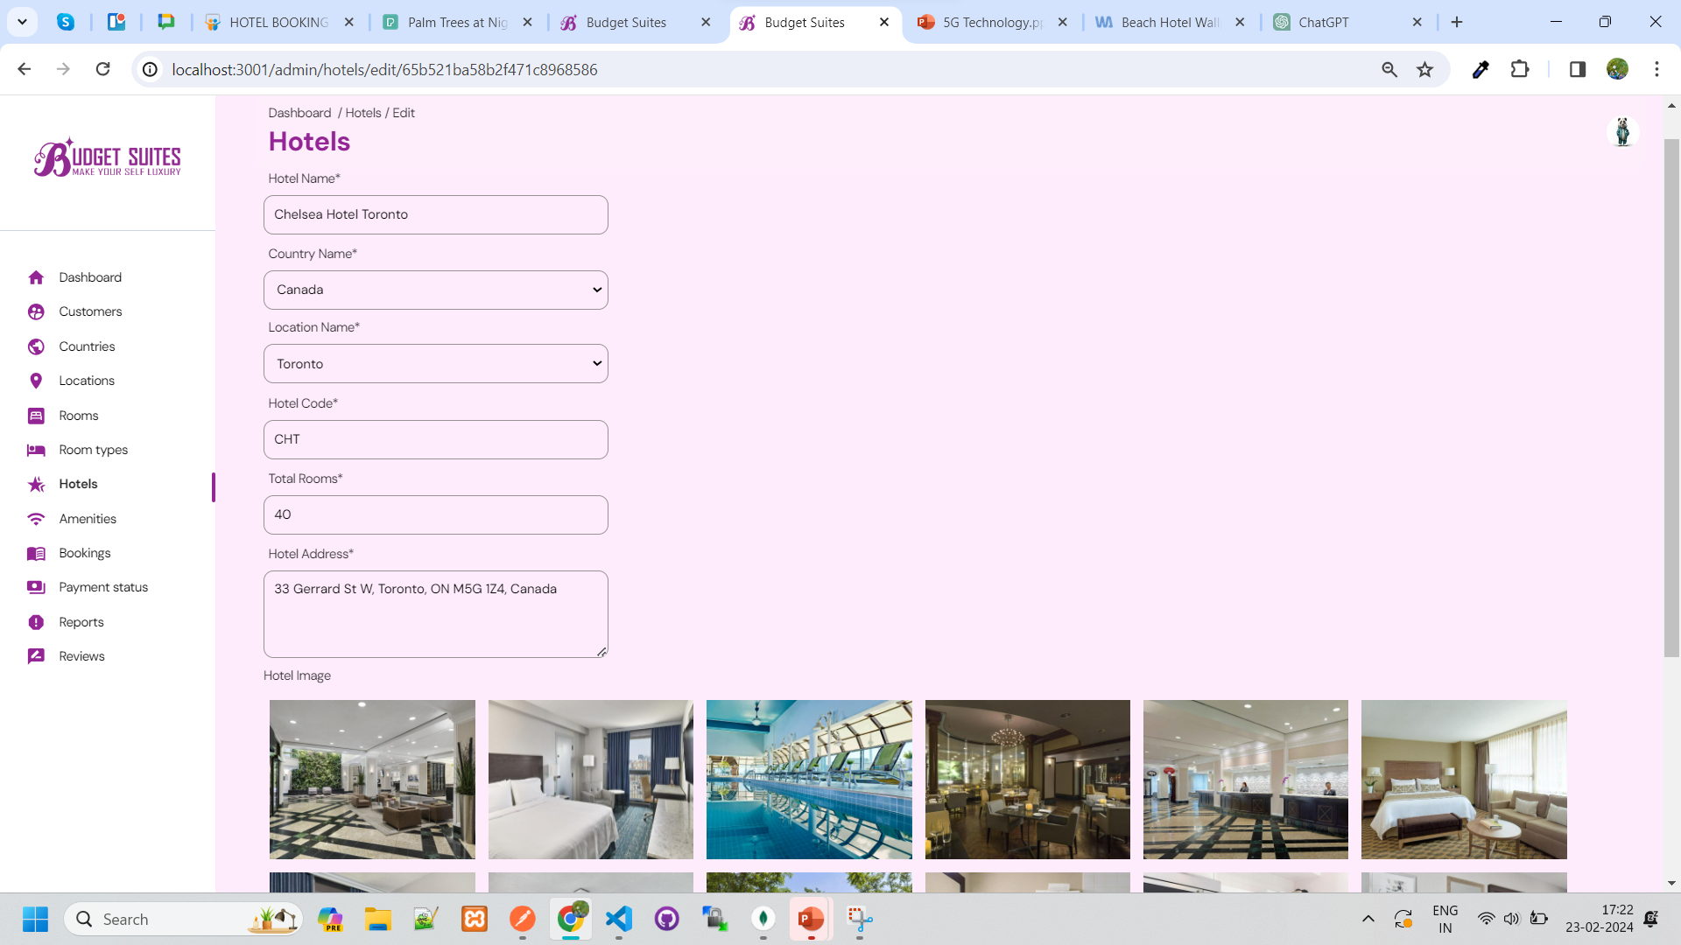
edit Hotel

Slide 41
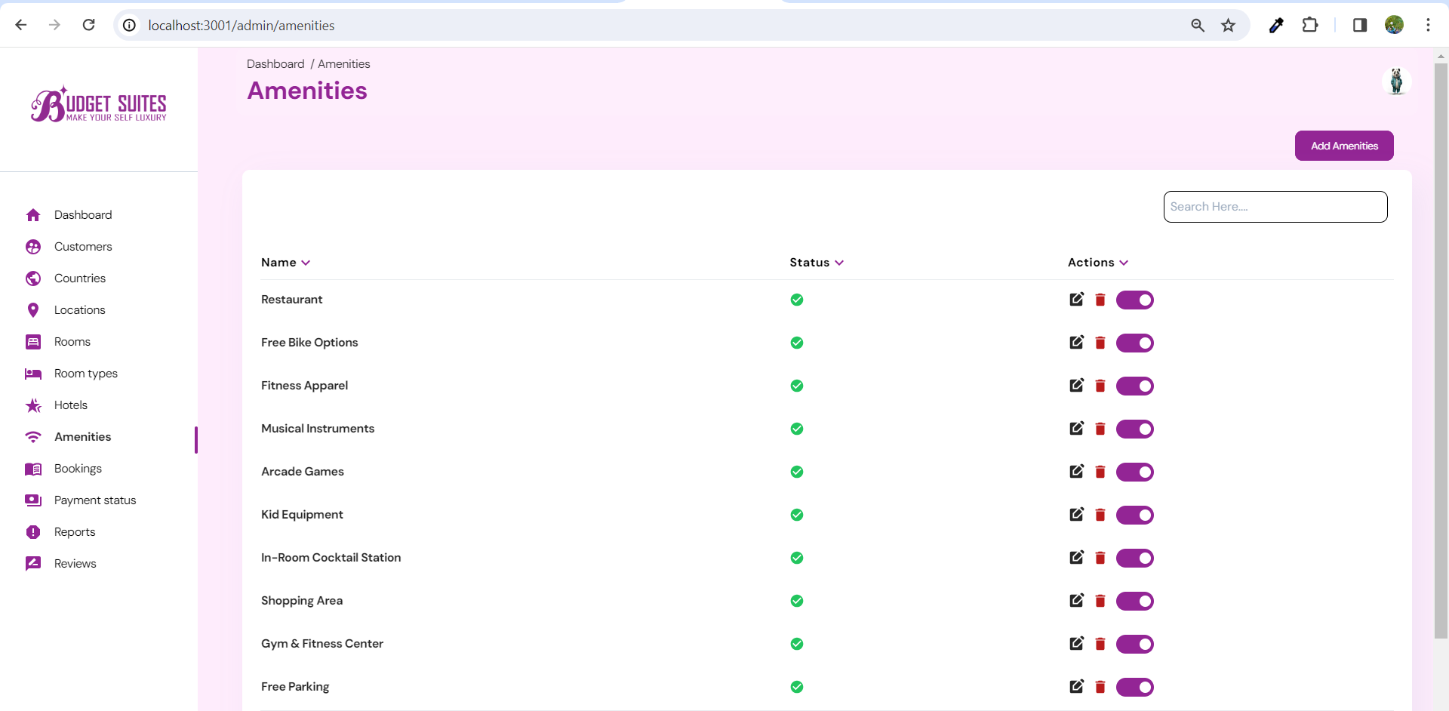
Amenities LIST

Slide 42
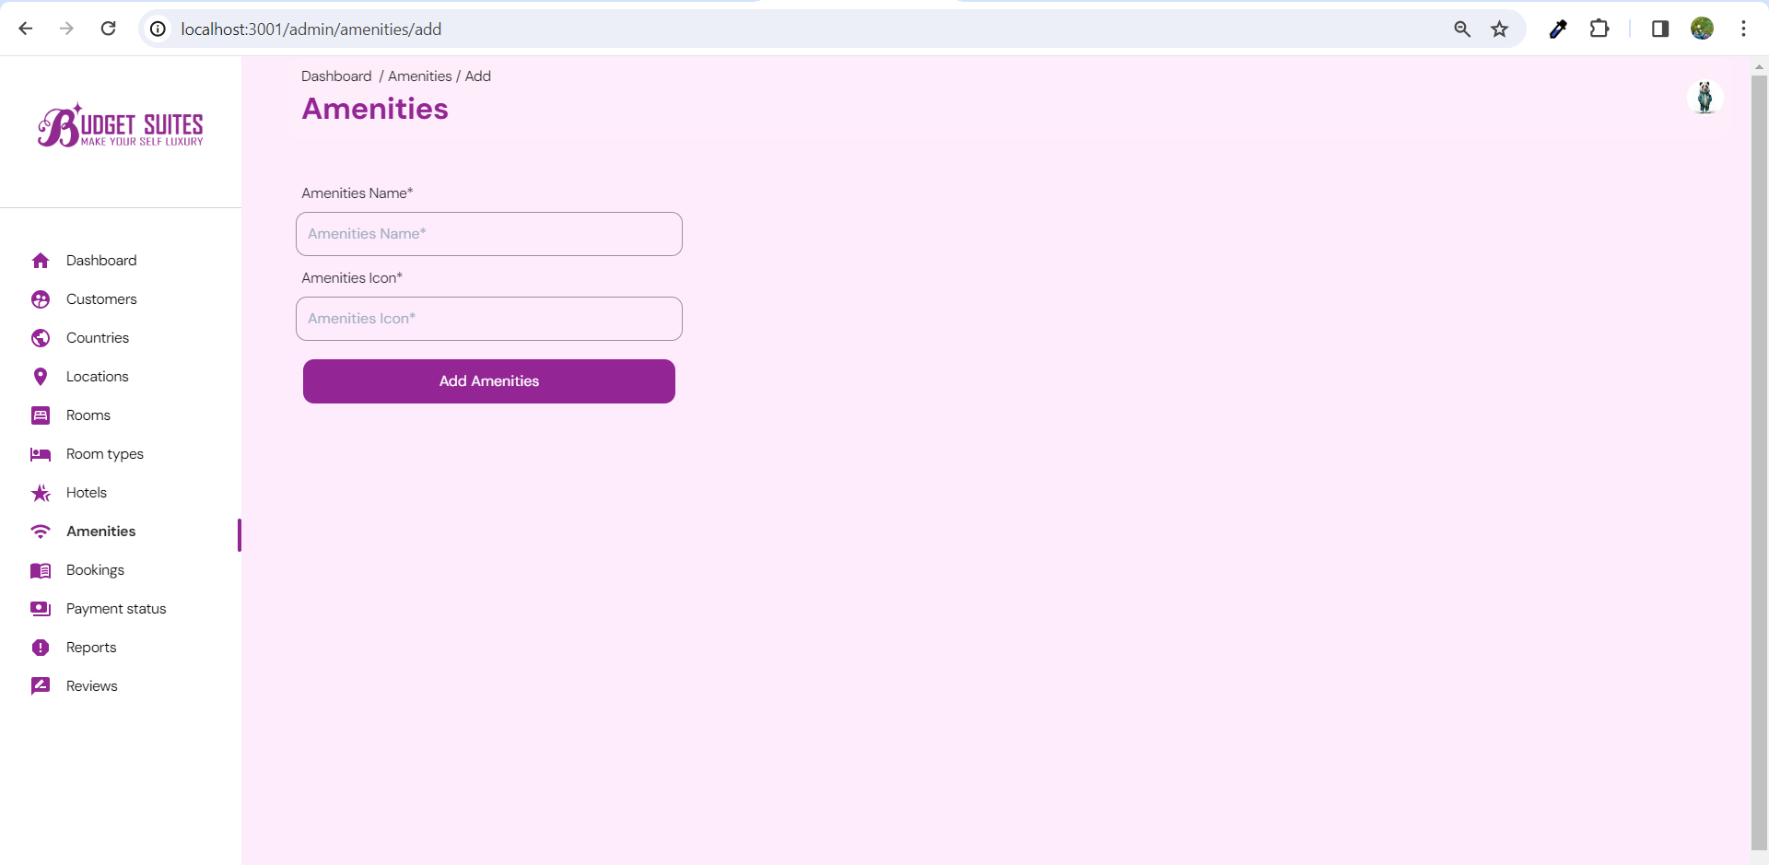
add Amenity

Slide 43
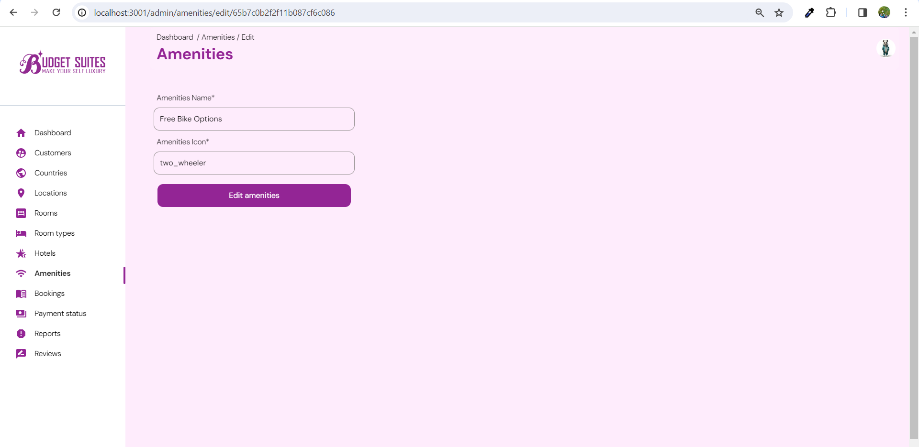
edit Amenity

Slide 44
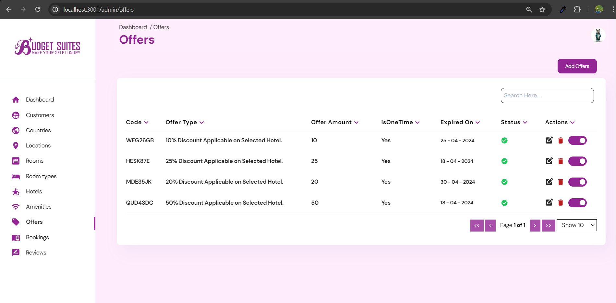
Offers list

Slide 45
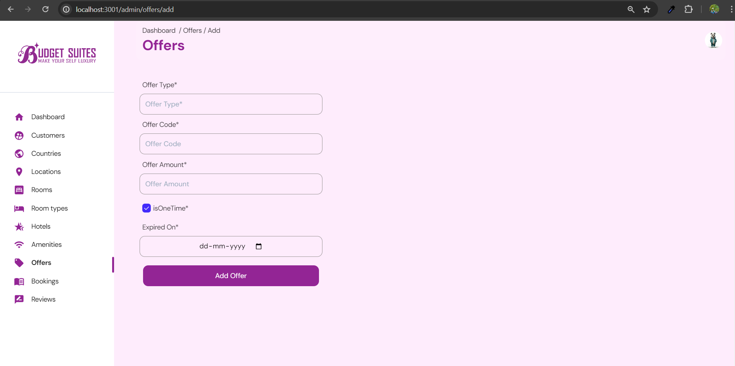
Add offer

Slide 46
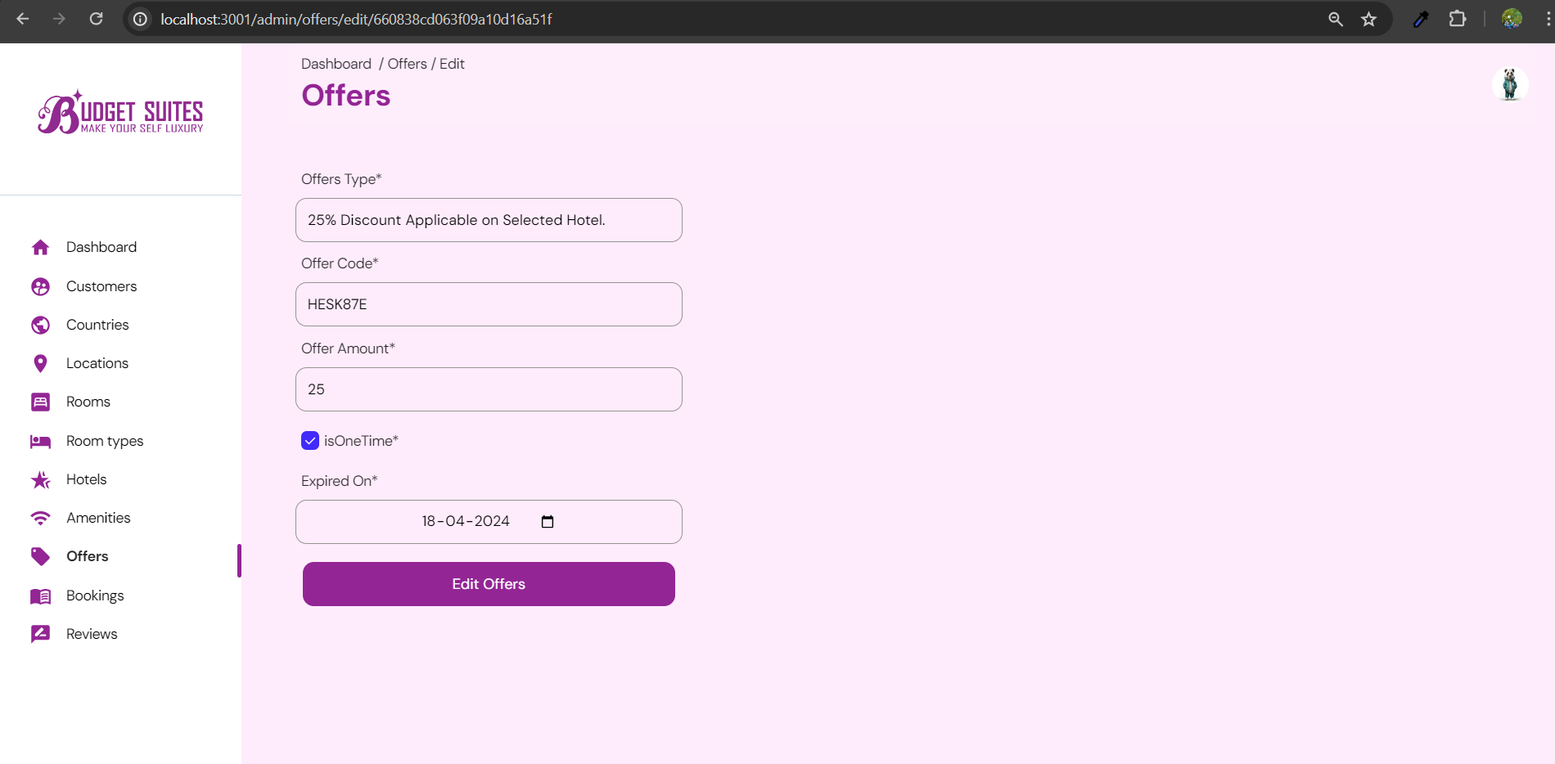
Edit offer

Slide 47
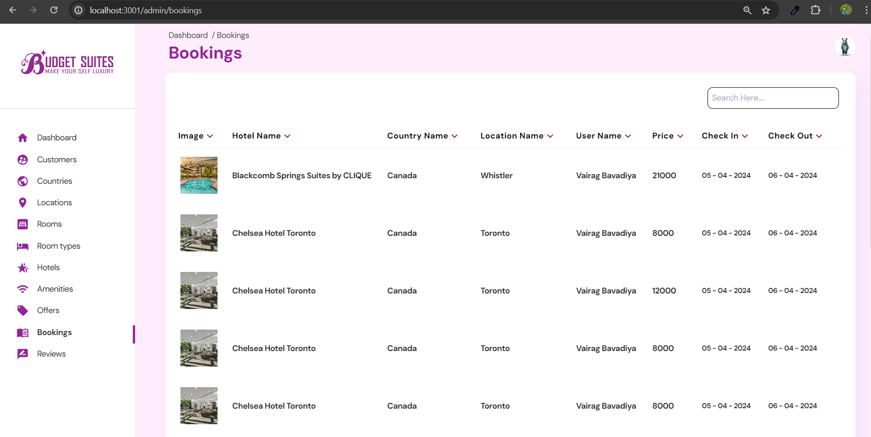
bookings

Slide 48
SnapShots
User Side

Slide 49
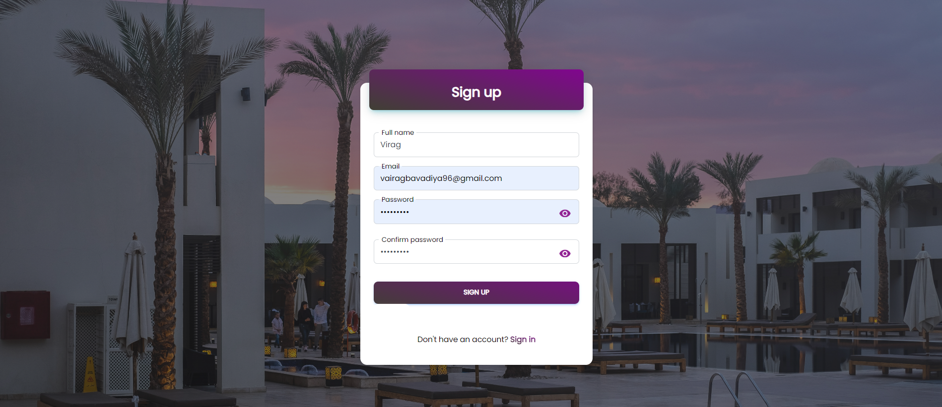
Sign-up page

Slide 50
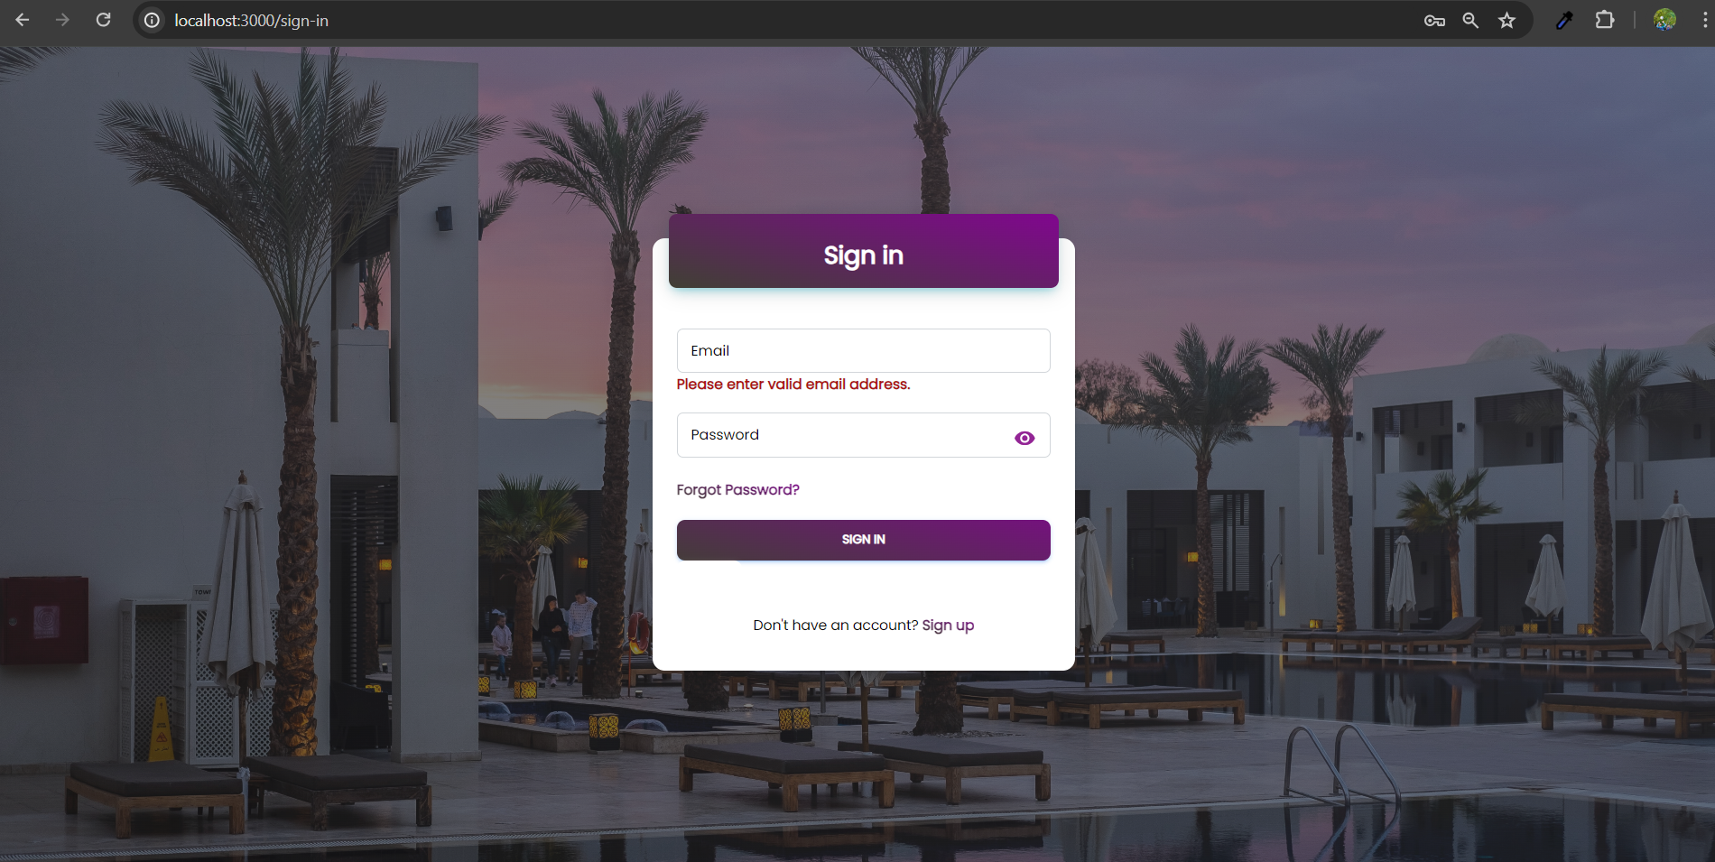
Sign-IN validation

Slide 51
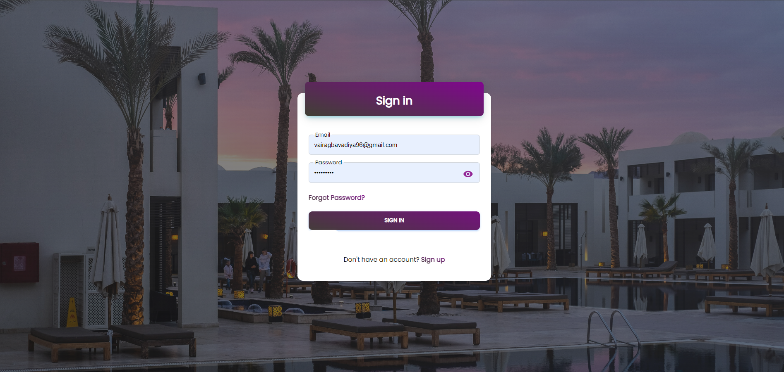
Sign-in page

Slide 52
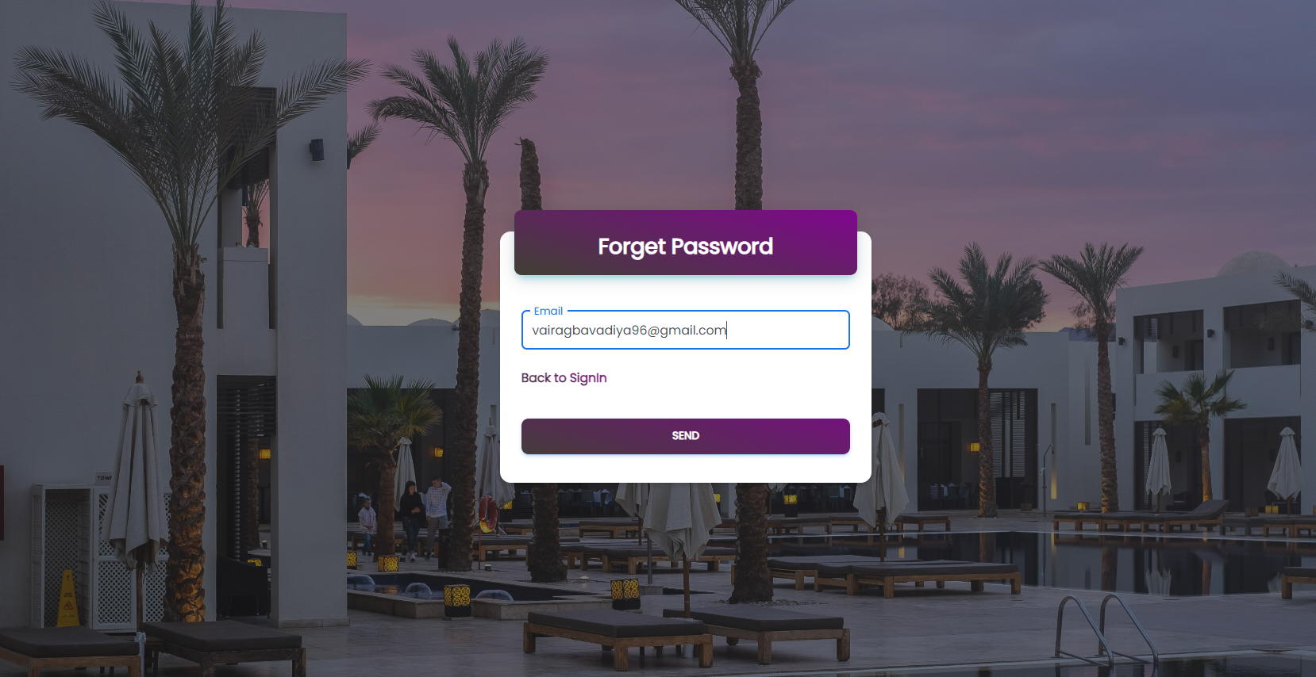
Forgot password

Slide 53
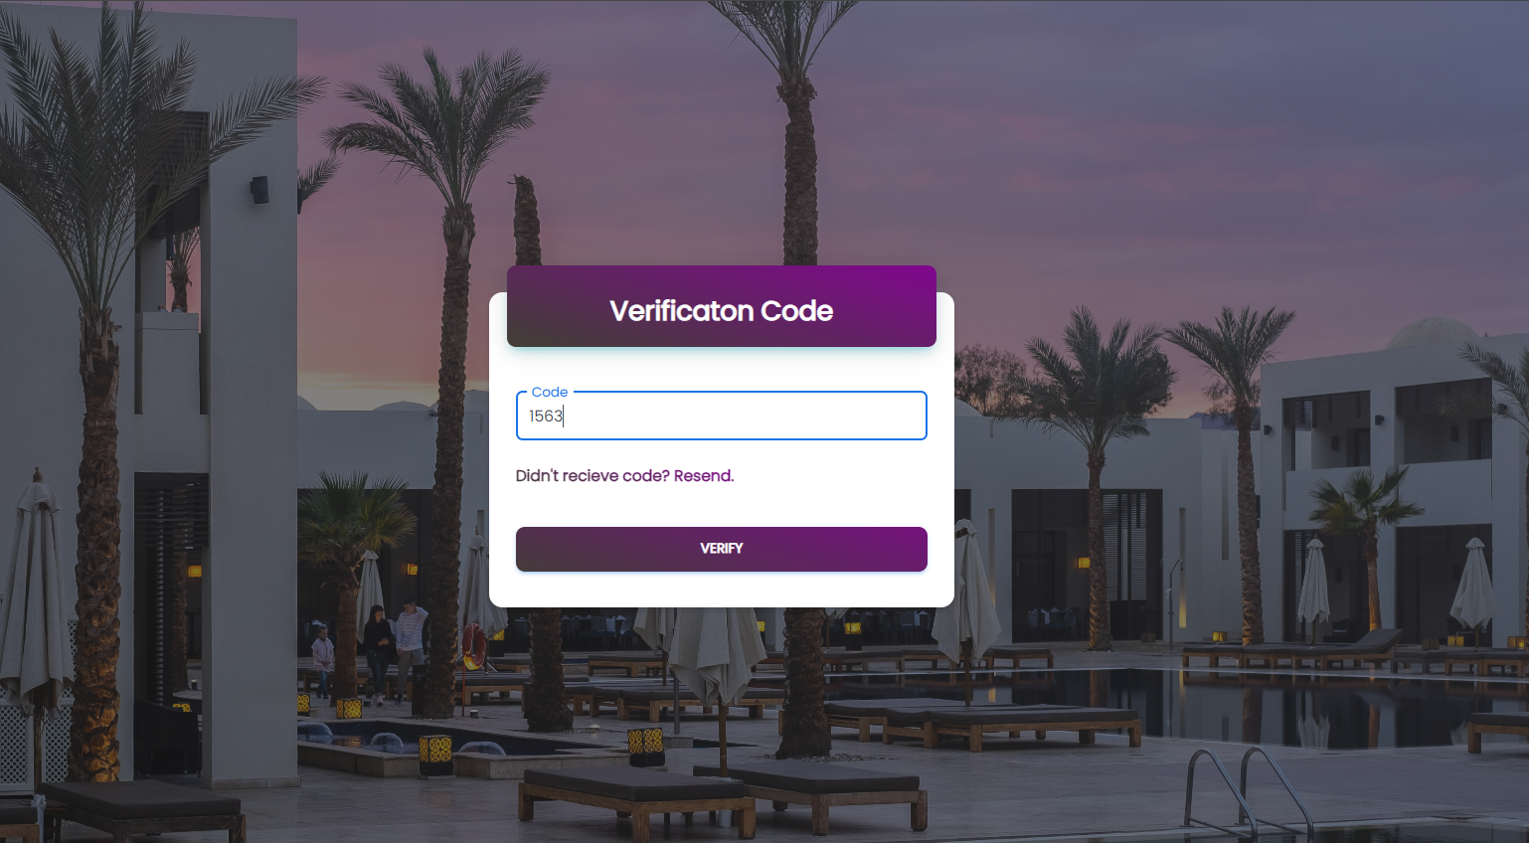
Verification code

Slide 54
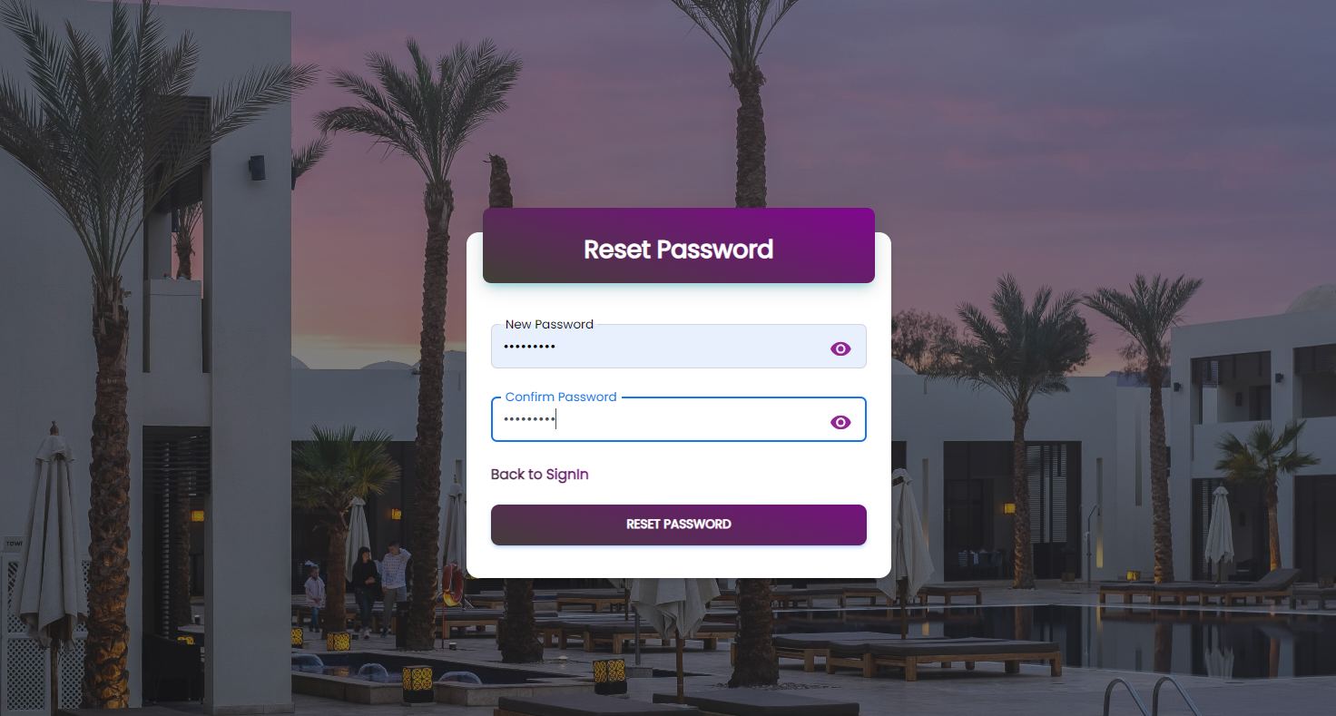
Reset password

Slide 55
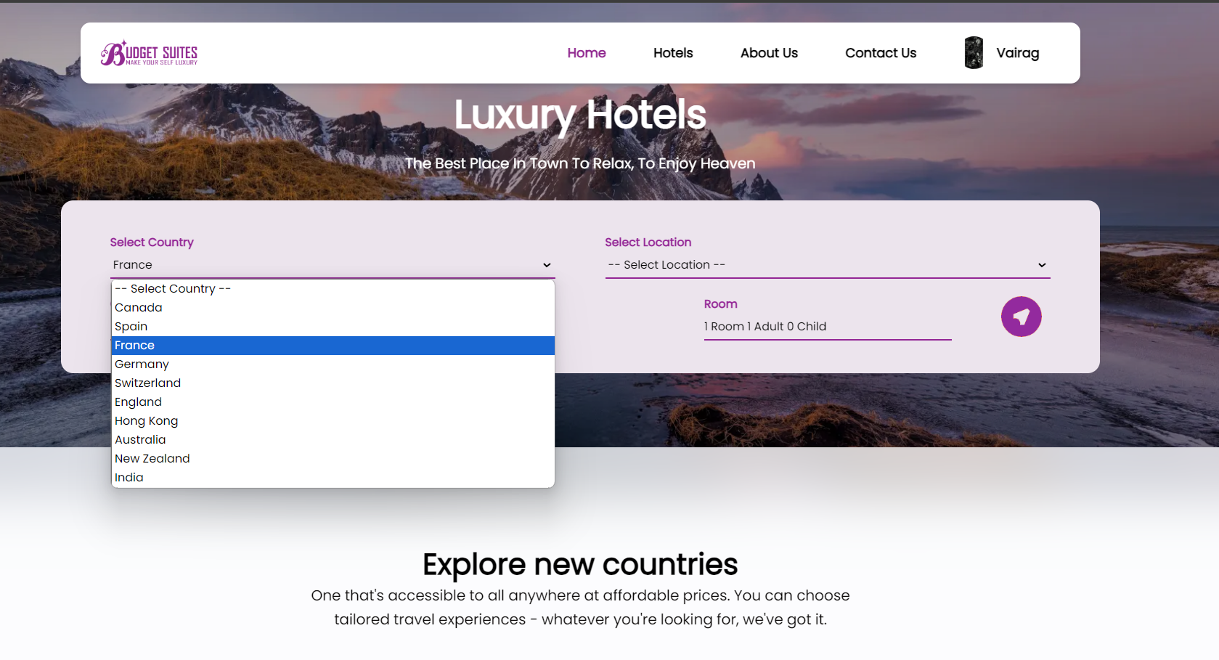
Search hotel

Slide 56
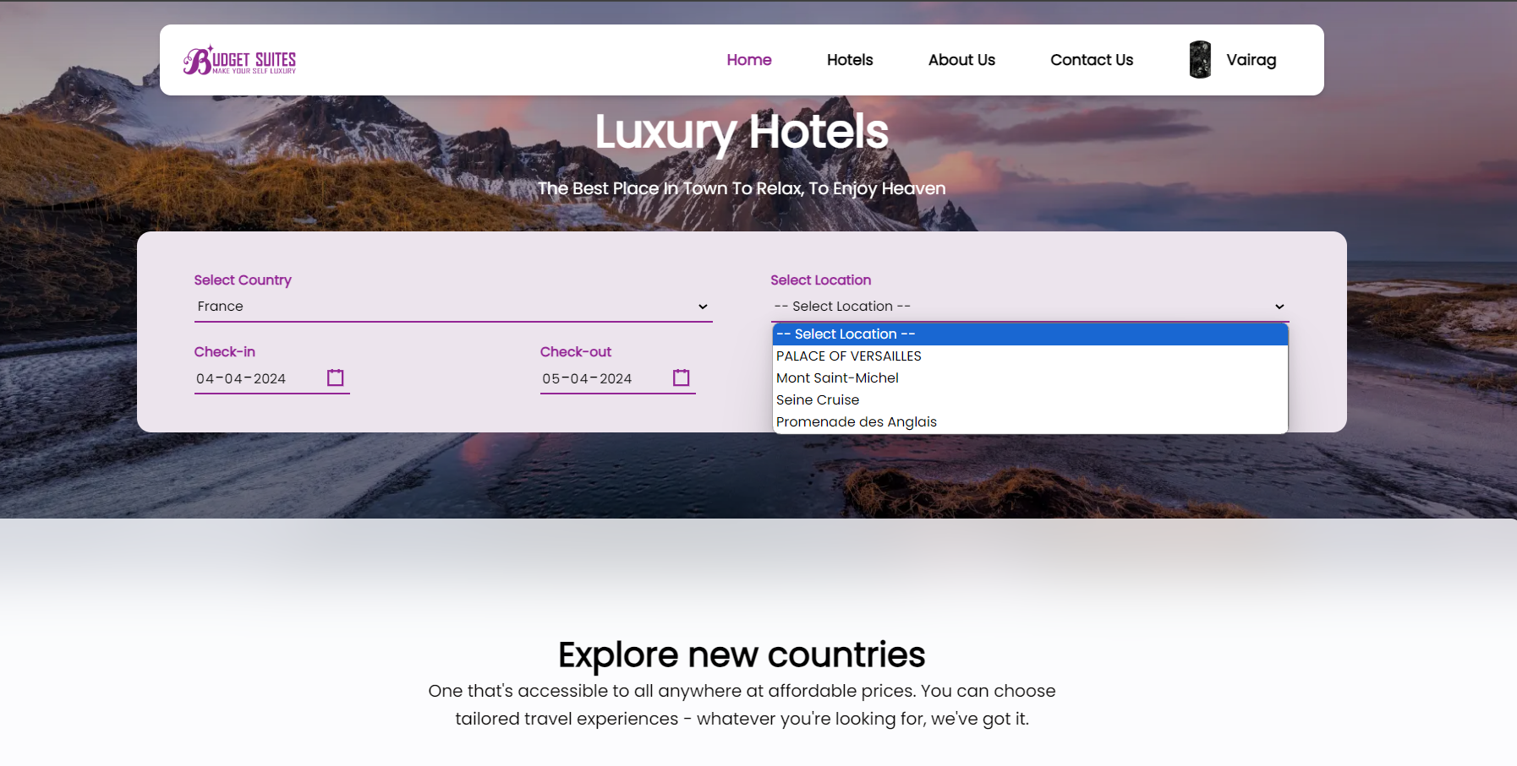
Search hotel functionalities

Slide 57
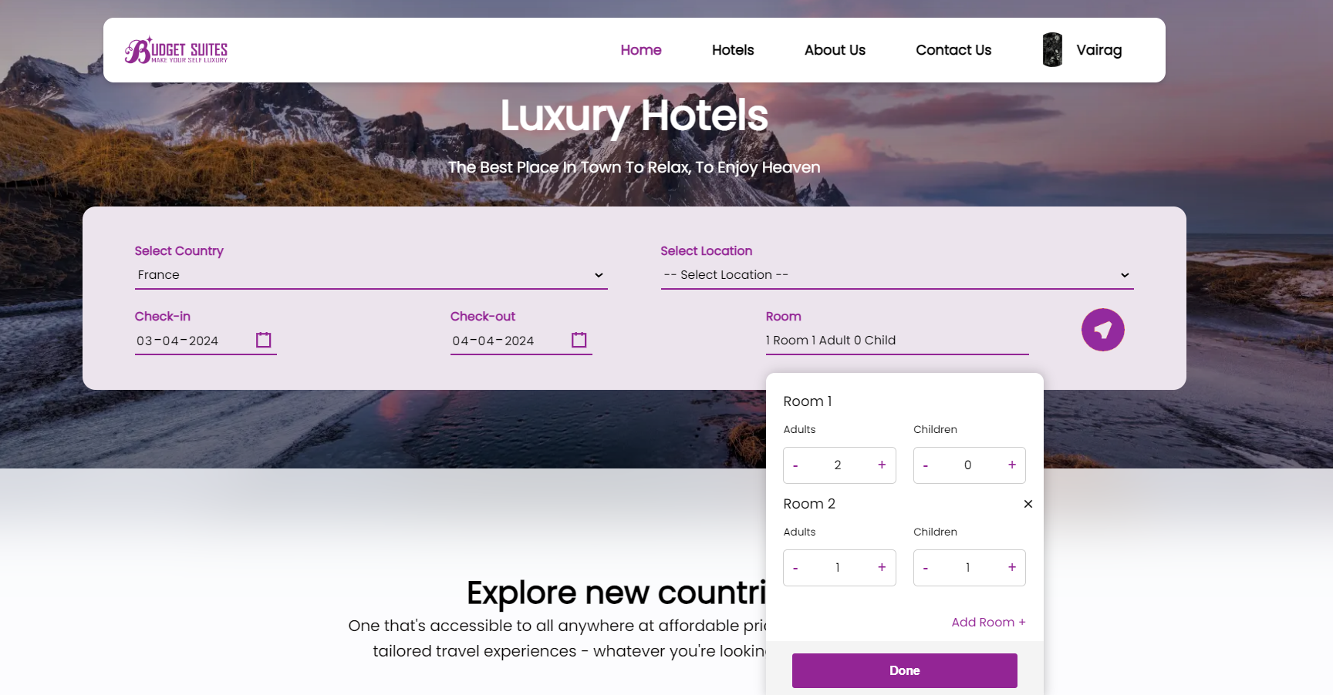
Search hotel functionalities

Slide 58
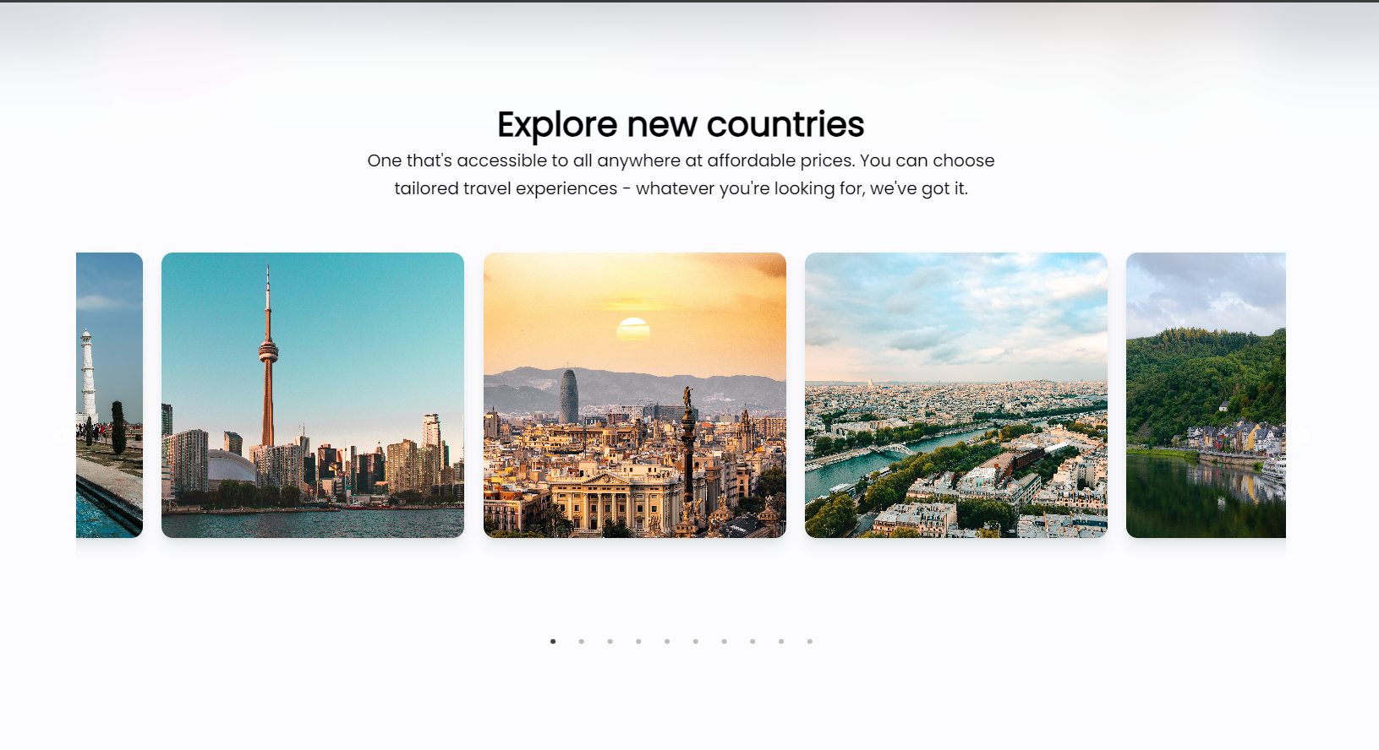
Home page

Slide 59
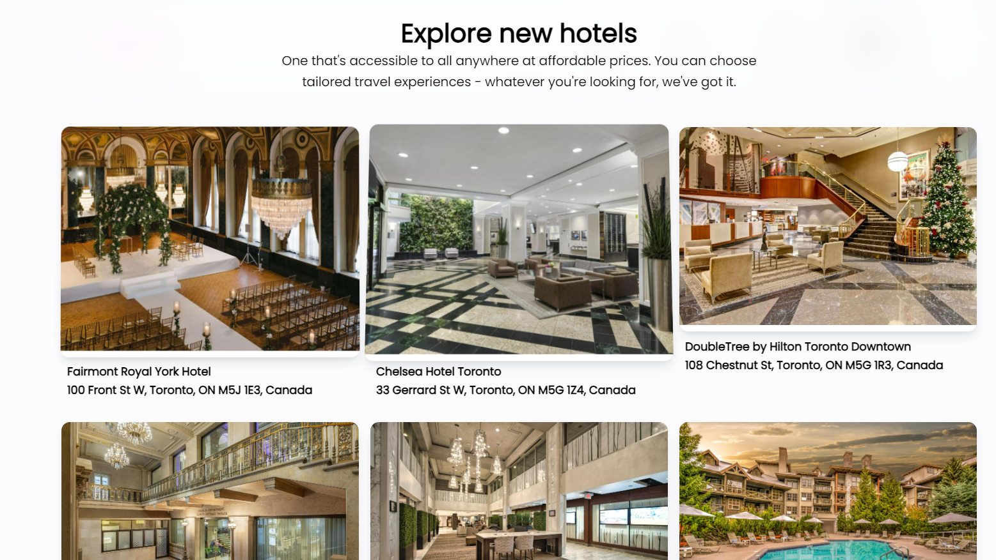
Home page

Slide 60
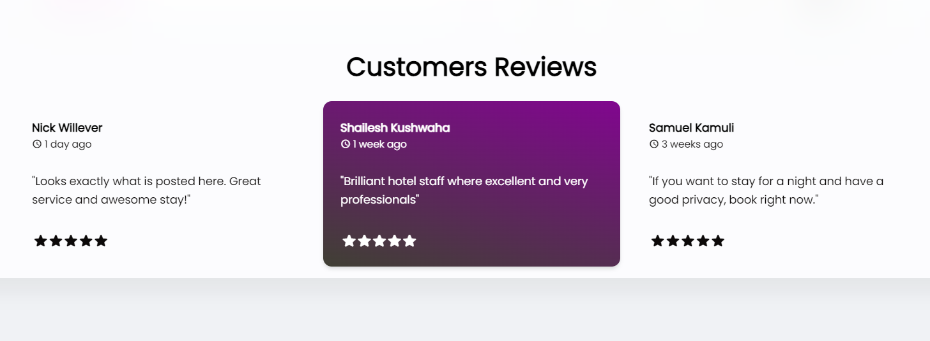
Home page

Slide 61
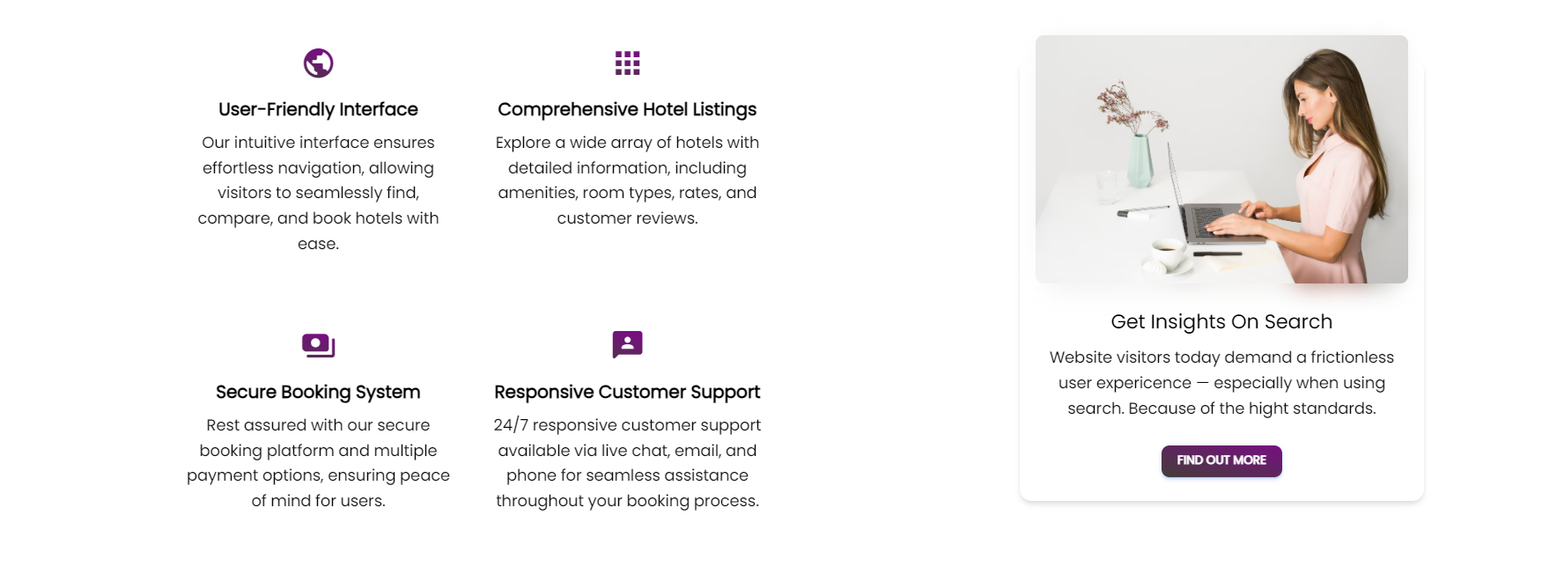
About us

Slide 62
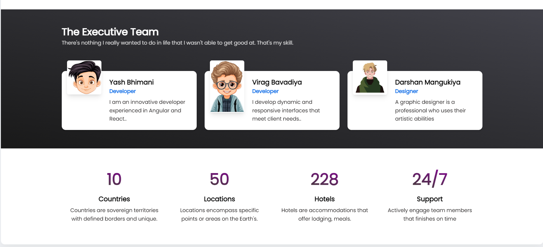
About us

Slide 63
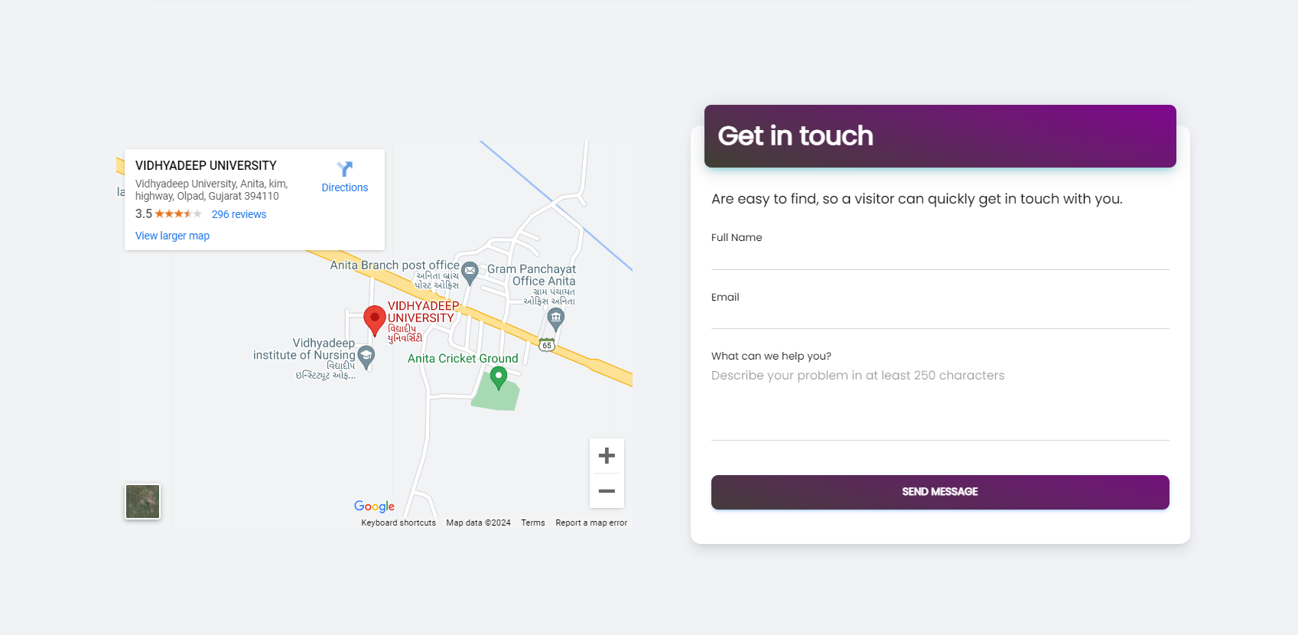
Contact us

Slide 64
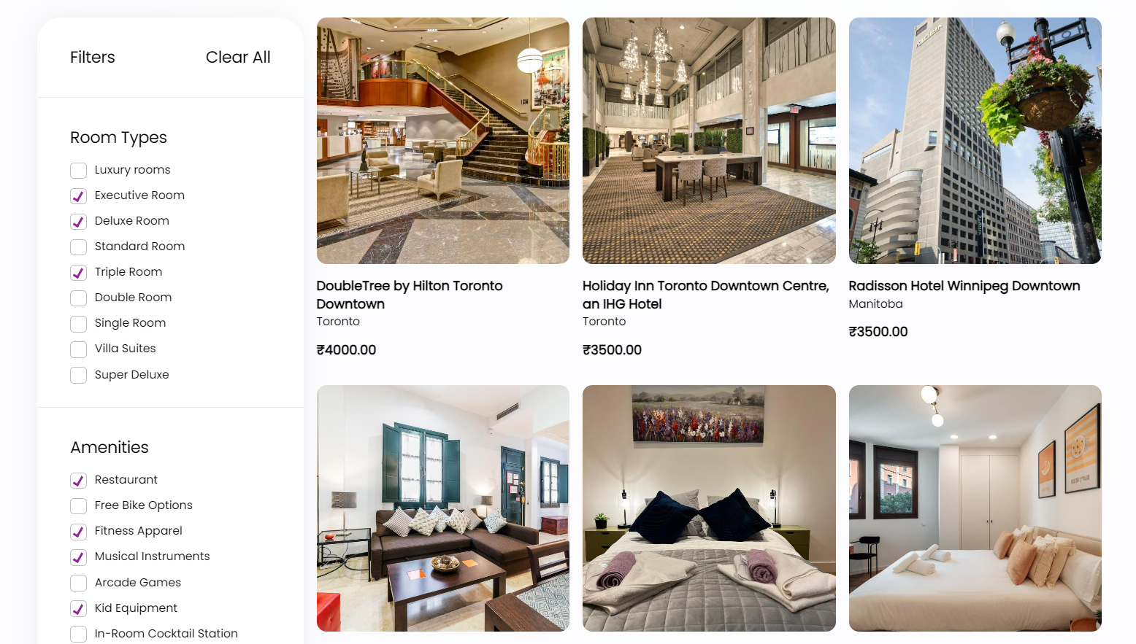
Hotels List

Slide 65
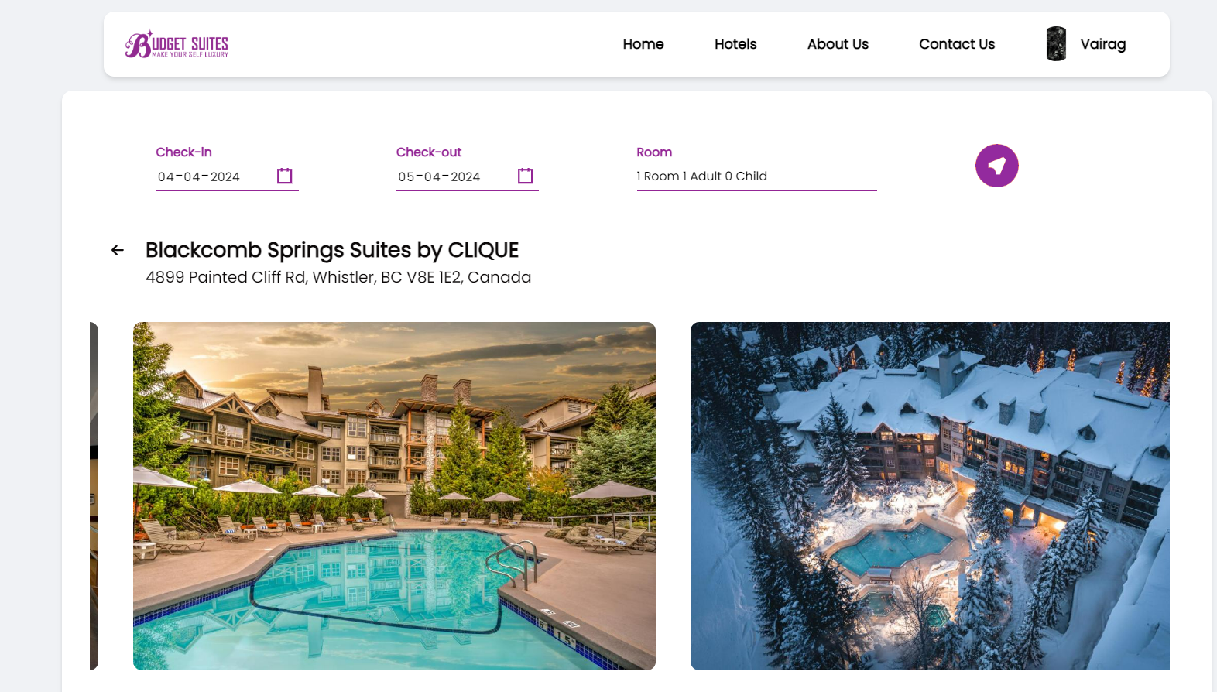
Hotel Details

Slide 66
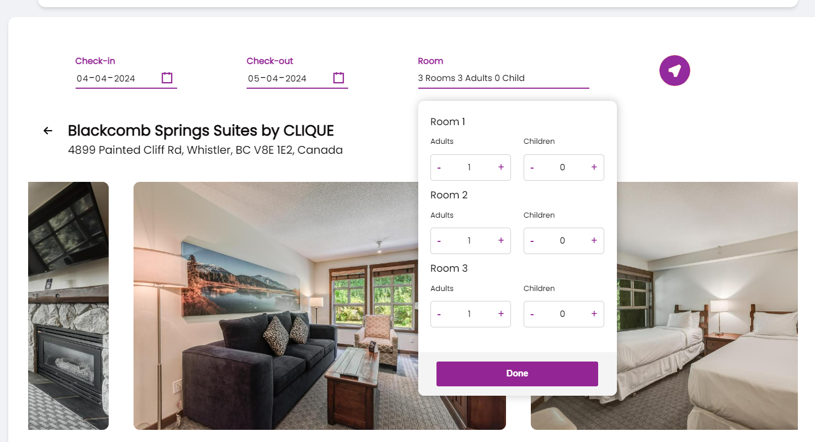
Hotel Details Functionalities

Slide 67

Hotel Details Functionalities

Slide 68

Hotel booking

Slide 69

Hotel booking with discount

Slide 70

payment

Slide 71

User’s profile validation

Slide 72

User’s profile

Slide 73

User’s booking

Slide 74

Security

Slide 75

offers

Slide 76

Footer

Slide 77
THANK YOU

